Slide 1
Current, Past, and Future Representations of Land Use and Land Cover in CESM
Peter Lawrence – Project Scientist - TSS
CESM Tutorial – August 10 2022
Notes:
NOTE: Background image can be used as is or changed for a particular presentation in the “Slide Master” button found under the “View” tab.

Slide 2
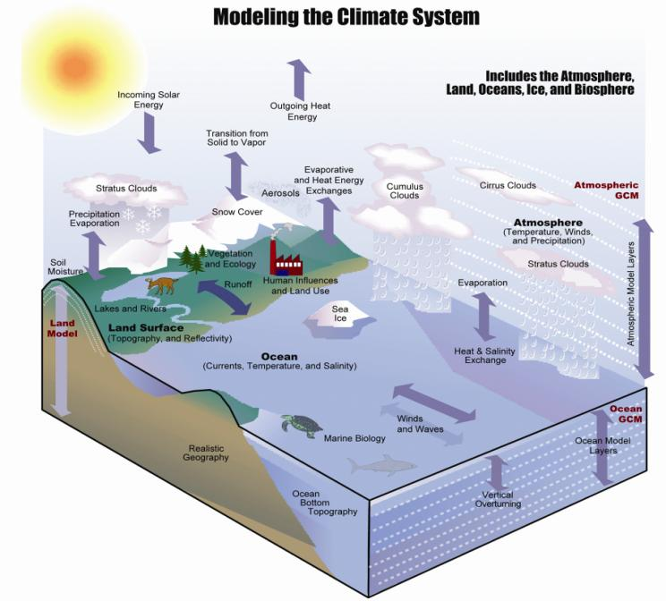
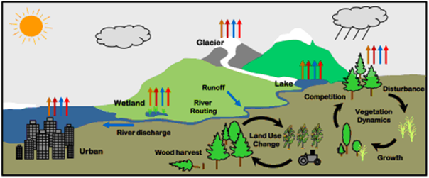
Understanding the role of Land in the Climate System: Investigations with an Earth System Model (NCAR CESM)
The land is a critical interface through which:
1. We study climate and climate change impacts on humans and ecosystems
and
2. The impact that humans and ecosystems can force on the environment and climate

Slide 3
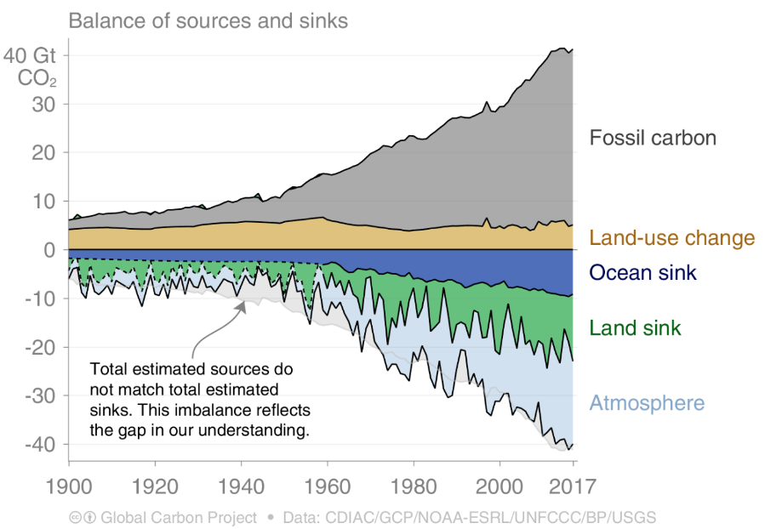
Slide 3 – IPCC Land Cover Change b
Land Cover Change Contribution to Carbon Emissions
Notes:
Overview of the talk

Slide 4
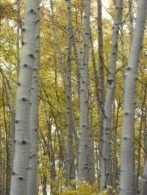
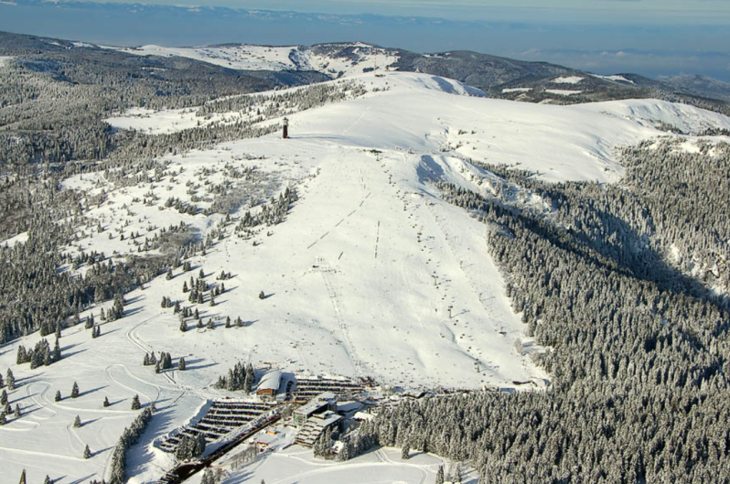
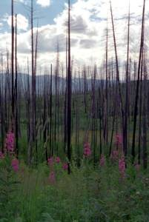
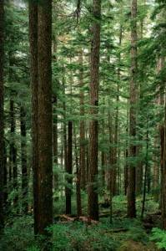
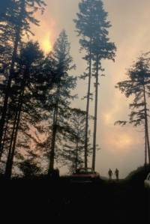
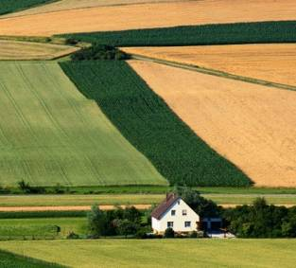
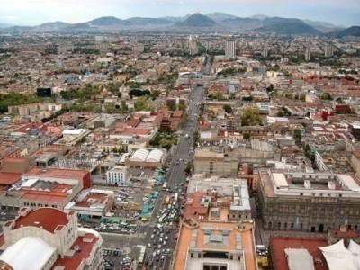
Slide 4 – Land Cover Change
Land Cover Change Biogeophysics
Growth
Growth
Forestry
Afforestation
Agriculture
Urban
Notes:
Overview of the talk

Slide 5
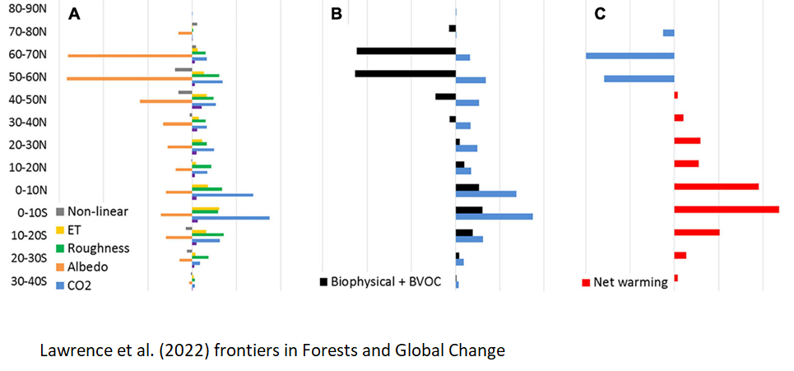
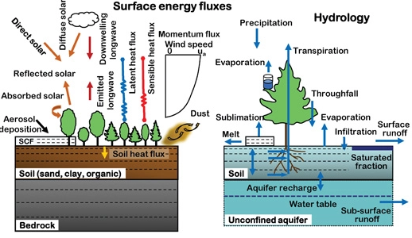
Slide 4 – Land Cover Change
Land Cover Change Deforestation Impacts
Growth
Growth
Forestry
Afforestation
Agriculture
Urban
Notes:
Overview of the talk

Slide 6
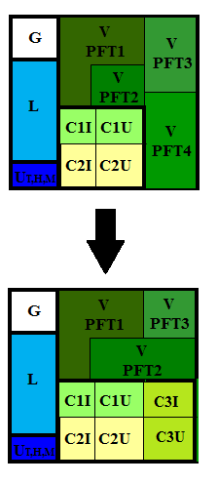
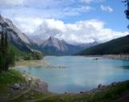
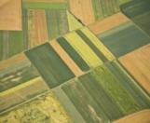
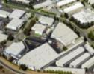
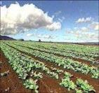
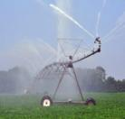
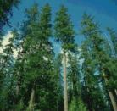
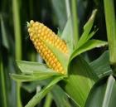
CLM5 Land Cover – Prescribed Annual Changes
Gridcell
CLM 5 LULCC for Natural PFT and Crop
Landunit
TBD
HD
Vegetated
Lake
MD
Glacier
Crop
Urban
Column
Annual
Land Use
Change
Unirrig
Unirrig
Irrig
Unirrig
Irrig
PFT1
PFT2
Crop1
Crop1
Crop2
Crop2 …
Notes:
This is a schematic of the subgrid structure of the land model. There are four distinct heirarchies in the model. There is the gridcell level. A gridcell is divided up into landunits, columns, and plant functional types or pfts.
Landunits are glacier, wetland, vegetated, lake, and now urban. Beneath the vegetated landunit is at least one soil type. Plant functional types then share this soil type and the energy and water budgets associated with this.

Slide 7
CLM5 Land Use – Prescribed Wood Harvest (biomass)
Gridcell
G
V
PFT1
V
PFT3
Landunit
V
PFT2
L
C1I
C1U
V
PFT4
TBD
HD
Vegetated
Lake
MD
Glacier
Crop
C2I
C2U
Urban
UT,H,M
Column
Soil
PFT
PFT1
PFT2
PFT3
PFT4 …
Notes:
This is a schematic of the subgrid structure of the land model. There are four distinct heirarchies in the model. There is the gridcell level. A gridcell is divided up into landunits, columns, and plant functional types or pfts.
Landunits are glacier, wetland, vegetated, lake, and now urban. Beneath the vegetated landunit is at least one soil type. Plant functional types then share this soil type and the energy and water budgets associated with this.

Slide 8
CLM5 Land Use – Crop Model Prescribed Management
Gridcell
CLM 5 LULCC for Natural PFT and Crop
G
V
PFT1
V
PFT3
Landunit
V
PFT2
L
C1I
C1U
V
PFT4
TBD
HD
Vegetated
Lake
MD
Glacier
Crop
C2I
C2U
Urban
UT,H,M
Crop Model
Leaf
emergence
Planting
Irrig
Unirrig
Irrig
Unirrig
Irrig /
Fertilize
Harvest
Grain fill
Crop1
Crop1
Crop2
Crop2 …
Notes:
This is a schematic of the subgrid structure of the land model. There are four distinct heirarchies in the model. There is the gridcell level. A gridcell is divided up into landunits, columns, and plant functional types or pfts.
Landunits are glacier, wetland, vegetated, lake, and now urban. Beneath the vegetated landunit is at least one soil type. Plant functional types then share this soil type and the energy and water budgets associated with this.

Slide 9
CLM5 Land Use Data Tool

Slide 10
Slide 1 - Title
Land Representation - CLM5 Land Data Technote
Notes:
Opening Slide

Slide 11
Slide 3 – IPCC Land Cover Change b
CESM Land Cover Change and Global Carbon Cycle
Notes:
Overview of the talk

Slide 12
Slide 6 – PFT Mapping
CESM LULCC vs no LULCC – Historic Eco Carbon
CESM NoLUC has large
uptake of carbon
from CO₂ fertilization,
Climate and N Deposition
CLM5 +142.7 PgC
This is offset by LULCC
in CESM = 182.9 PgC
Global Estimates ~160 PgC
Notes:
Overview of the talk

Slide 13
Slide 6 – PFT Mapping
CESM LULCC Conversion and Wood Harvest
CESM NoLUC has large
uptake of carbon
from CO₂ fertilization,
Climate and N Deposition
CLM5 +142.7 PgC
This is offset by LULCC
in CESM = 182.9 PgC
Global Estimates ~160 PgC
CLM5 conversion of PFTs
and CFTs results in a
cumulative loss of 59.3 PgC
CLM5 wood harvest of tree
PFTs results in a cumulative
loss of 60 PgC over the
period.
Notes:
Overview of the talk

Slide 14
Slide 6 – PFT Mapping
CESM LULCC Fire and Food Harvest
CESM NoLUC has large
uptake of carbon
from CO₂ fertilization,
Climate and N Deposition
CLM5 +142.7 PgC
This is offset by LULCC
in CESM = 182.9 PgC
Global Estimates ~160 PgC
CLM5 LULCC results in
large increase in carbon
loss through increased fire
of +60.5 PgC
CLM5 LULCC results in
large crop harvest flux out of
the land of 159 PgC
Much of the crop harvest
flux is offset in the LULCC
simulation by higher NPP
from fertilizer and lower
heterotrophic respiration
Notes:
Overview of the talk

Slide 15
Slide 6 – PFT Mapping
CLM5 LULCC vs no LULCC – Biogeophysics Change
Notes:
Overview of the talk

Slide 16
Slide 6 – PFT Mapping
CESM LUMIP SSP3-7.0 vs no LULCC Tot Eco Carbon
CESM NoLUC had large
even larger uptake of carbon
from CO₂ in SSP3-7.0 with
+372.0 PgC
This is offset by the very
large LULCC in the scenario
with CESM simulating a
LULCC of 179.3 PgC
Notes:
Overview of the talk

Slide 17
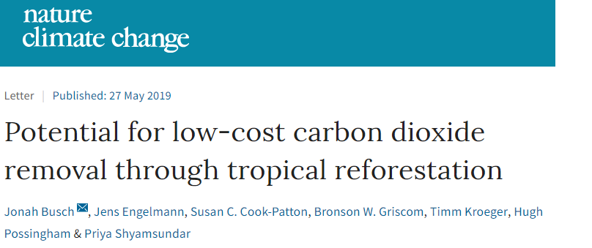
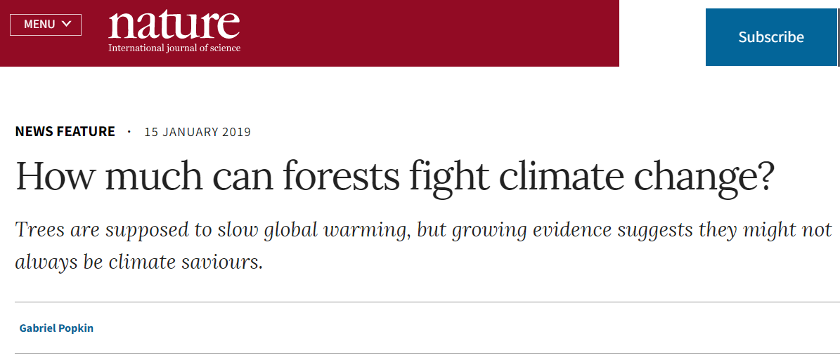
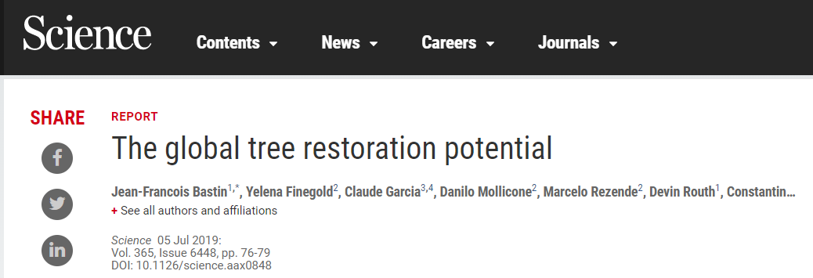
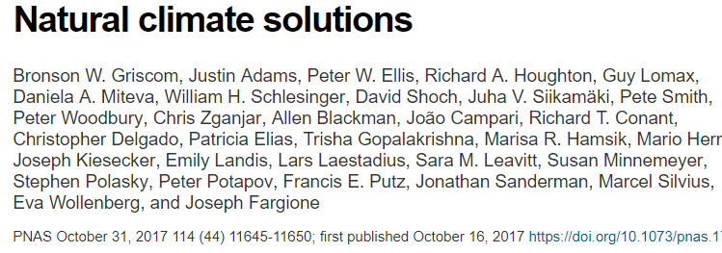
CESM – Carbon Dioxide Removal (CDR)
The carbon dioxide removal potential for large scale Reforestation and Afforestation has been receiving much attention in both the literature and the press.
Range of results upper end has:
Re/Afforestation of 9 million km²
With 205 PgC additional storage
(Cumulative emissions ~500 PgC)
Notes:
As complexity of development increases, there is need to consolidate models and resources

Slide 18
CLM5 RCP 2.6 Re/Afforestation – Total Eco Carbon 139 PgC
Notes:
This is a schematic of the subgrid structure of the land model. There are four distinct heirarchies in the model. There is the gridcell level. A gridcell is divided up into landunits, columns, and plant functional types or pfts.
Landunits are glacier, wetland, vegetated, lake, and now urban. Beneath the vegetated landunit is at least one soil type. Plant functional types then share this soil type and the energy and water budgets associated with this.

Slide 19
CLM5 RCP 2.6 Re/Afforestation – Air Temp / Evapotrans
Notes:
This is a schematic of the subgrid structure of the land model. There are four distinct heirarchies in the model. There is the gridcell level. A gridcell is divided up into landunits, columns, and plant functional types or pfts.
Landunits are glacier, wetland, vegetated, lake, and now urban. Beneath the vegetated landunit is at least one soil type. Plant functional types then share this soil type and the energy and water budgets associated with this.

Slide 20
CLM5 RCP 2.6 Re/Afforestation – Air Temp / Albedo / Solar
Notes:
This is a schematic of the subgrid structure of the land model. There are four distinct heirarchies in the model. There is the gridcell level. A gridcell is divided up into landunits, columns, and plant functional types or pfts.
Landunits are glacier, wetland, vegetated, lake, and now urban. Beneath the vegetated landunit is at least one soil type. Plant functional types then share this soil type and the energy and water budgets associated with this.

