Slide 1
Day 3: Diagnostics and Output
Jesse Nusbaumer
nusbaume@ucar.edu
Atmospheric Modeling and Predictability Software Engineer
Special thanks to Adam Phillips who did 99% of the work.

Slide 2
Outline
CESM2 output data and experiments
Introduction to the NetCDF format, ncdump
netCDF Operators (NCO) and Climate Data Operators (CDO)
Quick-use tools: ncview, panoply
Introduction to NCL
Introduction to Python and GeoCAT
Practical Lab #3
Diagnostics packages
NCL post-processing scripts
NCL graphics scripts
Additional Exercises
Challenges

Slide 3
Short-term Archive and Run Directories
/glade/scratch/<username>
Short-term
Archive Directory
/archive/$CASE
/$CASE
Run Directory
atm
lnd
ocn
ice
cpl
bld
run
logs
glc
rest
esp
rof
wave
I. CESM2 output data and experiments

Slide 4
Short-term Archive Directory
/glade/scratch/<username>
/archive/$CASE
By default, short term archiver writes to
/glade/scratch/<username>/archive/$CASE on cheyenne. To modify this path set DOUT_S_ROOT in env_run.xml.
atm
lnd
ocn
ice
cpl
As of CESM2 long term archiving can no longer be used.
logs
glc
rest
esp
rof
wave
I. CESM2 output data and experiments

Slide 5
CESM History File Naming Conventions
All history output files are written in NetCDF format.
Location of history files in short-term archive directory:
/glade/scratch/<username>/archive/$case/<component>/hist
component = atm, ocn, etc.
CESM distinguishes between different time sampling frequencies by creating distinct history files for each frequency. Sampling frequencies are set by the user within the namelist.
Example history file names:
f40_test.cam.h0.1993-11.nc f40_test.clm2.h0.1993-11.nc
f40_test.pop.h.1993-11.nc f40_test.cice.h.1993-11.nc
By default, h0/h denotes that the time sampling frequency is monthly.
Other frequencies are saved under the h1, h2, etc file names: f40_test.cam2.h1.1993-11-02-00000.nc
I. CESM2 output data and experiments

Slide 6
CESM History Files vs. Timeseries Files
History files contain all variables for a component for a particular frequency, and are output directly from the model.
Timeseries files are created offline from the model, either by the official CESM workflow post-processing scripts (limited support, run on Cheyenne/DOE machines), or by individual user-generated scripts. Timeseries files span a number of timesteps, and contain only one (major) variable.
Timeseries files are considerably more useful in day-to-day research and are regularly distributed while history files are not.
Example history file: f40_test.cam.h0.1993-11.nc
- 1 monthly timestep (Nov. 1993)
- 200+ CAM variables (ex. PSL, TS, PRECC..)
Example timeseries file: f40_test.cam.h0.PSL.199001-199912.nc
- 120 monthly timesteps (Jan 1990 – Dec 1999)
- 1 CAM variable (PSL), along with auxiliary variables (time,lat,etc.)
I. CESM2 output data and experiments

Slide 7
CESM CMIP5/6 Files
CESM CMIP files are similar to CESM timeseries files.
Example CMIP file: zg_Amon_CESM2_historical_r1i1p1f1_gn_185001-201412.nc.nc
- 1980 monthly timesteps (Jan 1850 – Dec 2014)
- 1 variable (zg), along with auxiliary variables (time,lat,etc.)
CESM CMIP files are designed to match CMIP/CMOR conventions, and thus metadata and auxiliary variables (ex. time) may not match CESM timeseries files.
CMIP variables may be a 1-to-1 match to CESM variables, or they may not be. Examine the data/metadata to check.
I. CESM2 output data and experiments

Slide 8
CESM & time variable
The time coordinate variable in CESM history and timeseries files represents the end of the averaging period for variables that are averages.
This is different from the time expressed in the file name. For monthly files, the time given in the file name is correct.
Example File: f.e11.FAMIPC5CN.f09_f09.rcp85.ersstv5.toga.ens10.cam.h0.2017-12.nc
When the time
coordinate variable is
translated, the time is
00Z January 1st 2018,
even though the file
holds averaged
variables for
December 2017.
I. CESM2 output data and experiments

Slide 9
CESM & time variable
To verify the averaging period in the files, consult the time_bnds, time_bound or time_bounds variables in the file.
Example File: f.e11.FAMIPC5CN.f09_f09.rcp85.ersstv5.toga.ens10.cam.h0.2017-12.nc
When the time_bnds variable is translated, the time averaging period is shown to be from 00Z Dec 1st 2017 through 00Z Jan 1st 2018.
Why is this done? With the time set at the end of the averaging period, this allows CESM to store instantaneous and averaged variables within the same file.
This issue only affects CESM history and timeseries files, not CESM CMIP files.
Best practice: Always verify the averaging period as shown.
I. CESM2 output data and experiments

Slide 10
CESM Experiment Casename Conventions
A lot of information is stored in standardized CESM case names.
The convention is:
<compset char>.<code base>.<compset sname>.<resolution sname> [.opt_desc_string].<nnn>[opt_char]
<compset char> = 1 character, first letter of compset
<code base> = code base, “e21” for cesm2.1, “e20” for cesm2.0, “e10” for cesm1.0, ”c40” for ccsm4.0.
<compset sname> = compset shortname
<resolution sname> = resolution shortname
<.opt_desc_string> = optional descriptive string, to be kept short if possible
<nnn> = 3 digit number
[opt_char] = optional single lower-cased letter; allowed to distinguish
a group of cases that are very closely related
Examples: b.e21.B1850.f09_g16.CMIP6-piControl.001
f.e11.FAMIPCN.f09_f09.rcp85_ersstv5.005
One note about compsets: The first letter of the casename is indicative of the type of run it is: A coupled run (a “B” case), an atmosphere/land run (“F”), a land run (“I”), or an ocean/ice run (“G”). Other letters (A,Q,S,T,X) denoting less common configurations are also used.
I. CESM2 output data and experiments

Slide 11
CESM Experiments Websites
http://www.cesm.ucar.edu/experiments/
I. CESM2 output data and experiments

Slide 12
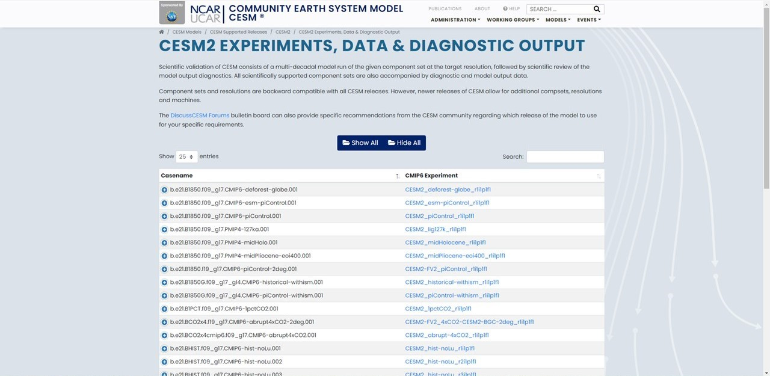
CESM Experiments Websites
https://csegweb.cgd.ucar.edu/experiments/public/
I. CESM2 output data and experiments

Slide 13
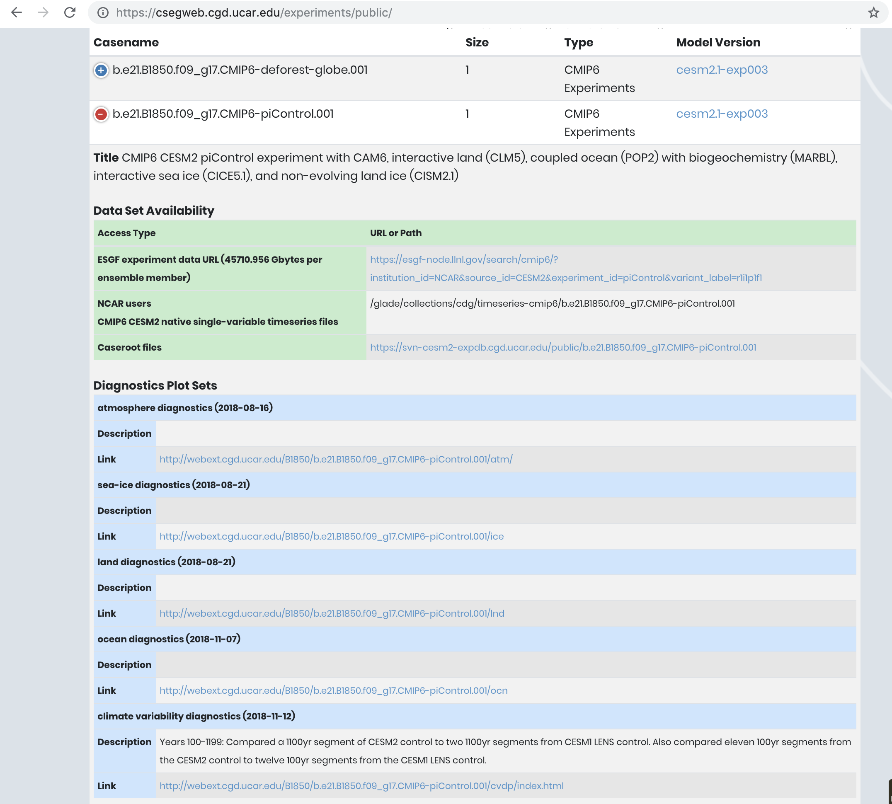
CESM Experiments Websites
Description of run with
list of active components
Links to data on ESGF
nodes and/or the NCAR-CDG;
cheyenne directory also listed.
Diagnostic links provided for
component packages and
the CVDP.
https://csegweb.cgd.ucar.edu/experiments/public/
I. CESM2 output data and experiments

Slide 14
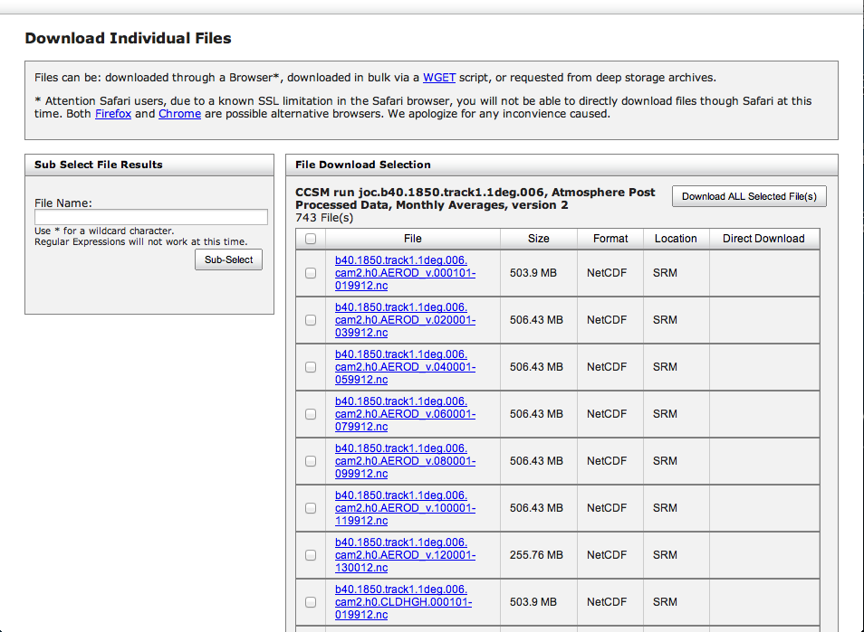
Climate Data Gateway at NCAR
Publicly released CESM data is available via the CDG.
Registration is quick and easy. NCAR accounts are not required.
Timeseries data in CESM and CMIP formats are available.
https://www.earthsystemgrid.org/
I. CESM2 output data and experiments

Slide 15
Notable CESM2 Simulations Currently Available
1850 Pre-industrial simulation w/CAM6 (2000yrs)
1850 Pre-industrial simulation w/WACCM6 (500yrs)
Large Ensemble (historical+ssp370 scenarios, 1850-2100,
100 members, 10 w/high frq output)
SSP2-4.5 Ensemble (ssp245 scenario, 2015-2100, 16 members)
CAM6 Prescribed SST AMIP Ensemble (1880-2021, 10 members)
I. CESM2 output data and experiments

Slide 16
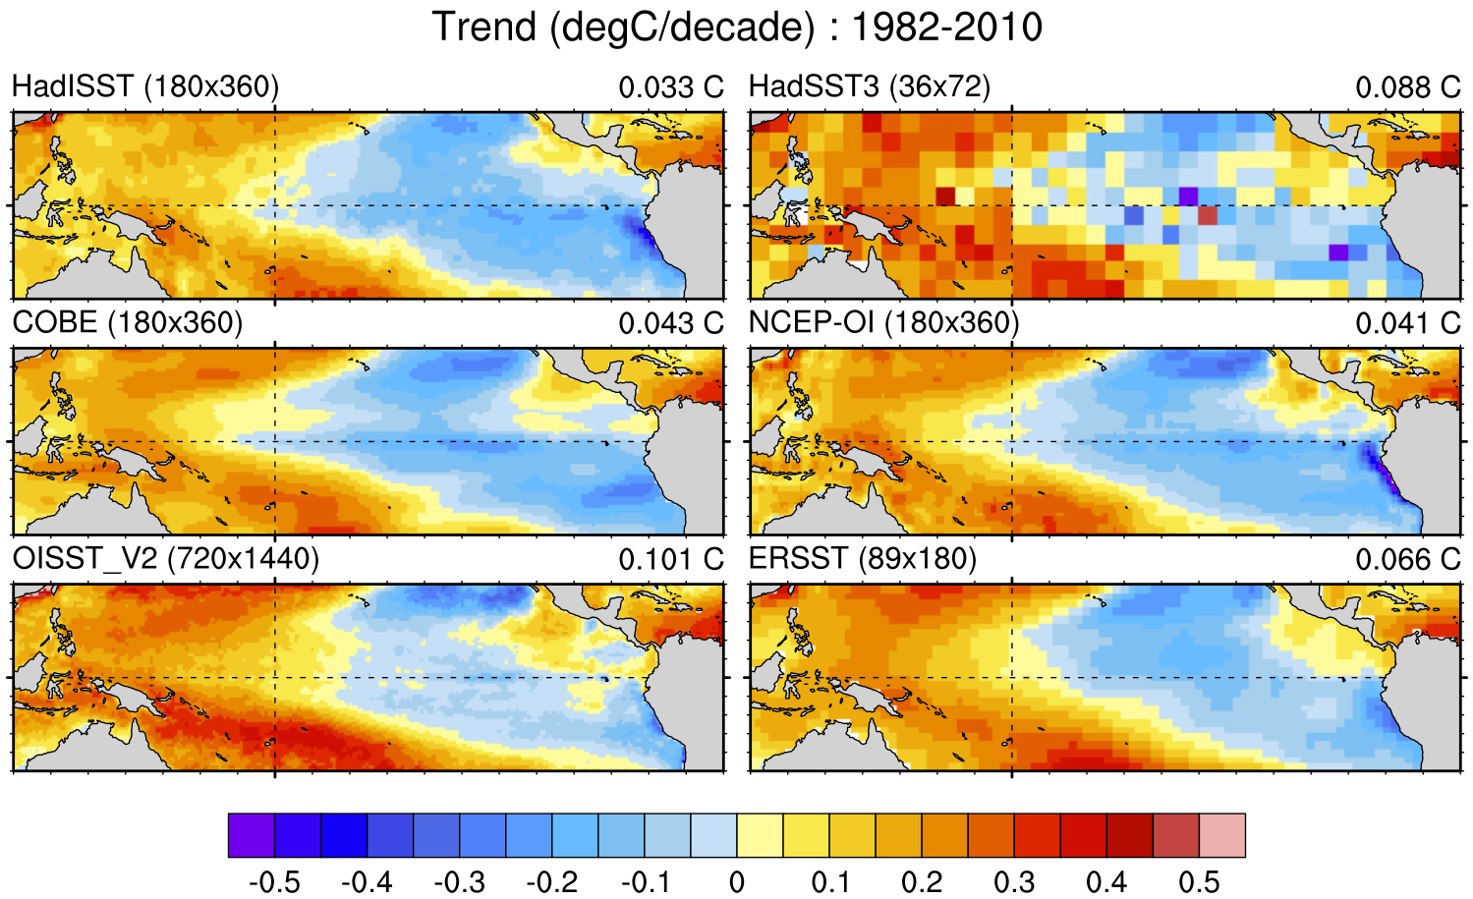
Concise and reliable expert guidance on the strengths, limitations and applications of climate data…
http://climatedataguide.ucar.edu
Describe observations used for Earth System Model evaluation; 150+ data sets profiled
Data set pros and cons evaluated by
nearly 4 Dozen Experts
(‘expert-user guidance’)
Comparisons of many common variables:
SST, precipitation, sea ice concentration,
atmospheric reanalysis, etc.
140,000 unique visitors in 2014
(up from 41,000 in 2012)
Comparison of SST data sets and their recent
trends in the tropical Pacific
For more info contact David P. Schneider, NCAR, Climate Analysis Section. dschneid@ucar.edu

Slide 17
Introduction to NetCDF
NetCDF stands for “network Common Data Form”
PROS: self-describing, portable, metadata friendly, supported by many languages including fortran, C, Matlab, ferret, GrADS, NCL, IDL, python; viewing tools like ncview/panoply; and tool suites of file operators (NCO, CDO).
CONS: compression not available until NetCDF4, oftentimes requires users to explicitly access information (not true in NCL or certain python packages like xarray)
http://www.unidata.ucar.edu/software/netcdf
http://www.unidata.ucar.edu/software/netcdf/docs/BestPractices.html
II. Introduction to the netCDF format, ncdump

Slide 18
netcdf slp.mon.mean {
dimensions:
lon = 144 ;
lat = 73 ;
time = UNLIMITED ; // (744 currently)
ncdump
ncdump is a netCDF utility that allows one to dump the contents of the netCDF file to screen or file.
variables:
float lat(lat) ;
lat:units = "degrees_north" ;
lat:actual_range = 90.f, -90.f ;
lat:long_name = "Latitude" ;
float lon(lon) ;
lon:units = "degrees_east" ;
lon:long_name = "Longitude" ;
lon:actual_range = 0.f, 357.5f ;
double time(time) ;
time:units = "hours since 1-1-1 00:00:0.0" ;
time:long_name = "Time" ;
time:actual_range = 17067072., 17609832. ;
float slp(time, lat, lon) ;
slp:long_name = "Sea Level Pressure" ;
slp:valid_range = 870.f, 1150.f ;
slp:actual_range = 960.1486f, 1082.558f ;
slp:units = "millibars" ;
slp:missing_value = -9.96921e+36f ;,
To view the header of a netCDF file:
ncdump –h slp.mon.mean.nc
To view the contents of a variable:
ncdump –v slp slp.mon.mean.nc | less
To view the netCDF file type:
ncdump –k slp.mon.mean.nc
result: netCDF-4
To print readable date-time strings:
ncdump –t –v time slp.mon.mean.nc
// global attributes:
:title = “Monthly mean slp from the NCEP Reanalysis" ;
:description = "Data is from NMC initialized reanalysis\n",
"(4x/day). These are the 0.9950 sigma level values." ;
:Conventions = "COARDS" ; }
II. Introduction to the netCDF format, ncdump

Slide 19
netCDF Operators (NCO)
NCO is a suite of programs designed to perform certain “operations” on netCDF files, i.e., things like averaging, concatenating, subsetting, or metadata manipulation.
Command-line operations are extremely useful for processing model data given that modelers often work in a UNIX-type environment.
UNIX wildcards are accepted for many of the operators.
The NCO’s recognize missing data by the _FillValue attribute.
(missing_value is ignored.)
The NCO Homepage and Reference Manual can be found at http://nco.sourceforge.net
Note: There are many other netCDF operators beyond what will be described here.
III. NCO netCDF Operators / CDO Climate Data Operators

Slide 20
netCDF Operators (NCO)
NCRA (netCDF record averager)
Example: ncra file1.nc file2.nc avgfile.nc
file1.nc = input model history file, for jan year 1
file2.nc = input model history file, for feb year 1
avgfile.nc = new file consisting of jan/feb averaged data for all
fields found in the input model history file.
NCRCAT (netCDF record concatenator)
Examples: ncrcat file1.nc file2.nc out12.nc
out12.nc = new model history time series file consisting of the months of jan and feb, year 1. Each time-varying field in this file now has 2 time steps.
III. NCO netCDF Operators / CDO Climate Data Operators

Slide 21
Introduction to netCDF Operators (NCO)
NCES (netCDF ensemble statistics, formerly NCEA)
Example: nces amip_r01.nc amip_r02.nc amip_r03.nc amip_ENS.nc
amip_r01.nc = input file from ensemble member #1
containing monthly Jan-Dec year 1 data
amip_r02.nc = same as above but contains data from ensemble member #2
amip_r03.nc = same as above but contains data from ensemble member #3
amip_ENS.nc = new file consisting of monthly Jan-Dec year 1 data
averaged across the 3 ensemble members.
NCDIFF (netCDF differencer)
Example: ncdiff amip_r01.nc amip_r02.nc diff.nc
diff.nc = contains the differences between amip_r01.nc and amip_r02.nc.
Note: Useful for debugging purposes.
III. NCO netCDF Operators / CDO Climate Data Operators

Slide 22
Introduction to netCDF Operators (NCO)
NCKS (netCDF “Kitchen Sink” = does just about anything)
Combines various netCDF utilities that allow one to cut and paste subsets of data into a new file.
Example: ncks –v TEMP f40_test.pop.h.1993-11.nc f40_test.TEMP.199311.nc
f40_test.pop.h.1993-11.nc = input model history file (monthly)
-v TEMP = only grab the TEMP variable
f40_test.TEMP.1993-11.nc = output file containing TEMP + associated
coordinate variables
Note #1: Only those variables specified by –v and their associated coordinate variables are included in the output file. As the variables date, TLAT, and TLONG are not coordinate variables of TEMP, they won’t be copied to the output file unless one does this:
ncks –v TEMP,date,TLAT,TLONG f40_test.pop.h.1993-11.nc f40_test.T.1993-11.nc
Note #2: Wildcards not accepted.
III. NCO netCDF Operators / CDO Climate Data Operators

Slide 23
Introduction to netCDF Operators (NCO)
Other commonly used operators:
NCATTED (attribute editor)
NCRENAME (rename variables, dimensions, attributes)
NCFLINT (interpolates data between files)
NCPDQ (pack to type short or unpack files)
III. NCO netCDF Operators / CDO Climate Data Operators

Slide 24
Introduction to netCDF Operators (NCO)
netCDF operator options
-v Operates only on those variables listed.
ncks –v T,U,PS in.nc out.nc
-x –v Operates on all variables except those listed.
ncrcat –x –v CHI,CLDTOT 1999-01.nc 1999-02.nc out.nc
-d Operates on a subset of data.
ncks -d lon,0.,180. -d lat,0,63 in.nc out.nc
Real numbers indicate actual coordinate values, while integers indicate actual array indexes. In the above example, all longitudes will be grabbed from 0:180E, and the first 64 latitudes indexes will be grabbed.
-h Override automatic appending of the global history attribute with the NCO command issued (which can be very long)
More options exist beyond what was discussed here.
III. NCO netCDF Operators / CDO Climate Data Operators

Slide 25
Introduction to netCDF Operators (NCO)
Note that you can wrap the NCO’s into a script
begin
syear= "1920" ; YYYY
eyear ="2029" ; YYYY
emonth = "12"
time_s = "{1,2}*" ; "0*" = default, {1,2}* for 20C simulations
mrun = "b.e11.B20TRLENS_RCP85.f09_g16.xbmb.011"
indir = "/glade/scratch/dbailey/archive/"+mrun+"/"
outdir = "/glade/scratch/asphilli/"+mrun+"/"
atm_vars = (/“PSL”,”PRECC","PRECL","TS"/)
;——————————————————————————————————————
if (.not.fileexists(outdir)) then
system("mkdir "+outdir)
end if
do gg = 0,dimsizes(atm_vars)-1
ofile = outdir+mrun+".cam.h0."+atm_vars(gg)+"."+syear+"01-"+eyear+emonth+".nc”
system("ncrcat –h -v "+atm_vars(gg)+" "+indir+"atm/hist/*.h0."+time_s+" "+ofile+” &")
end do
end
III. NCO netCDF Operators / CDO Climate Data Operators

Slide 26
Introduction to Climate Data Operators (CDO)
CDO are very similar to the NCO. Within the CDO library there are over 600 command line operators that do a variety of tasks including: detrending, EOF analysis, meta data modification, statistical analysis and similar calculations.
CDO are not currently used in the diagnostics packages, so we will not go into specifics here. We mention the CDO to make you aware of their existence.
The CDO Homepage can be found at:
https://code.zmaw.de/projects/cdo/
CDO documentation can be found at:
https://code.zmaw.de/projects/cdo/wiki/Cdo#Documentation
III. NCO netCDF Operators / CDO Climate Data Operators

Slide 27
ncview
ncview is a graphical interface which allows one to quickly view the variables inside a netCDF file.
Example: ncview file1.nc
ncview allows you to interactively visualize a selected variable across a selected range (time, spatial).
IV. Quick-use tools

Slide 28
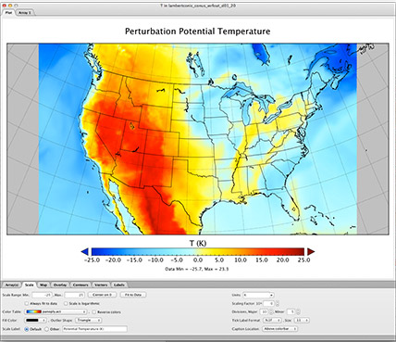
Panoply
Panoply is another GUI application that allows one to quickly view data in a netCDF, HDF, or GRIB format (amongst others). Similar to ncview, but more powerful, panoply allows the user to perform simple calculations, apply masks, and to quickly create spatial or line plots.
Note: v4.10.8 requires Java SE 8 runtime environment or newer. Documentation is improving, with numerous demonstration tutorials/videos and How-To’s.
The Panoply homepage can be found at:
http://www.giss.nasa.gov/tools/panoply/
IV. Quick-use tools

Slide 29
NCAR Command Language (NCL)
What NCL is known for:
Easy I/O. NetCDF, Grib, Grib2, shapefiles, ascii, binary.
Good graphics; utmost flexibility in design.
Functions tailored to the geosciences community.
All encompassing website with 1000+ examples.
Open source. Free to download and use.
For more information, or to get started learning NCL:
http://www.ncl.ucar.edu/get_started.shtml
Page through the NCL mini-language and processing manuals
http://www.ncl.ucar.edu/Document/Manuals
However, NCL is now in a maintenance stage, and most active development
has moved to Python.
http://www.ncl.ucar.edu
V. Introduction to NCL

Slide 30
Python
What Python is known for:
Open Source. Free to download and use.
Wide range of applications and packages available, along with a huge user base and ~1 gazillion online tutorials.
Active development in packages related to the geosciences.
If you are new to python and its application
To the geosciences, then I would recommend starting with Project Pythia:
https://foundations.projectpythia.org/landing-page.html
V. Introduction to NCL

Slide 31
Geoscience Community Analysis Toolkit (GeoCAT)
NCAR is working on a python-based replacement for NCL called GeoCAT. This includes functions for both plotting and analysis:
https://geocat.ucar.edu/
Just like NCL, the GeoCAT team is working on implementing a collection of
Examples to show how it can be used. You can find those examples here:
https://geocat-examples.readthedocs.io/en/latest/
MetPy
If you also work with weather data, then you might also want to checkout out MetPy, which is under UCAR as well:
https://unidata.github.io/MetPy/latest/
V. Introduction to NCL

Slide 32
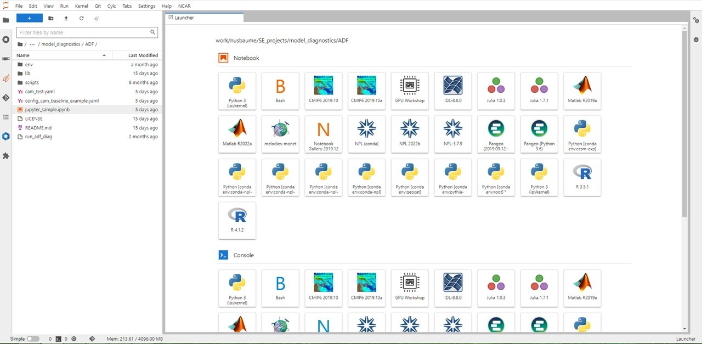
Jupyterhub
Jupyterhub is a web browser interface to the CISL machines, and allows for the creation and use of Jupyter notebooks:
https://jupyterhub.hpc.ucar.edu

Slide 33
Using NCL in Practical Lab #3
Within the lab, you are going to be provided NCL scripts that post-process the monthly model data that you created and draw simple graphics.
What is meant by post-processing: Convert the model history data from one time step all variables on one file to all time steps, one variable per file. (Also convert CAM 3D data from hybrid-sigma levels to selected pressure levels.)
The diagnostic script suites all use NCL (except the ADF), and you will have the opportunity to run these as well.
V. Introduction to NCL

Slide 34
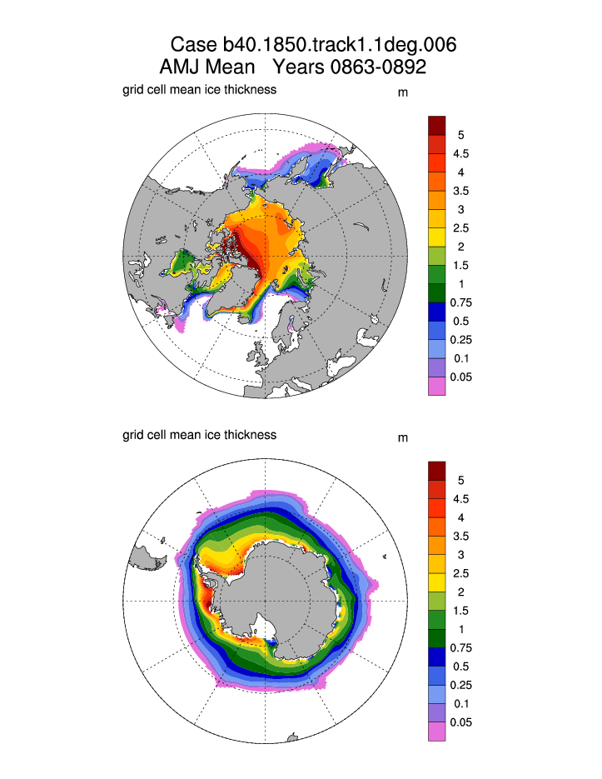
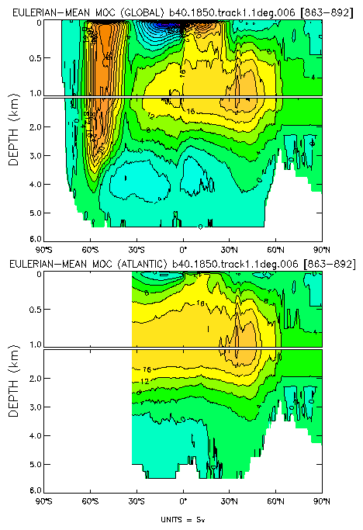
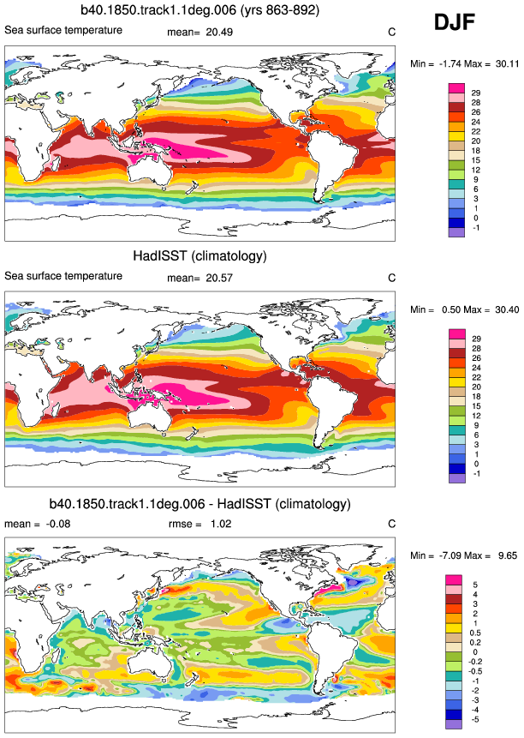
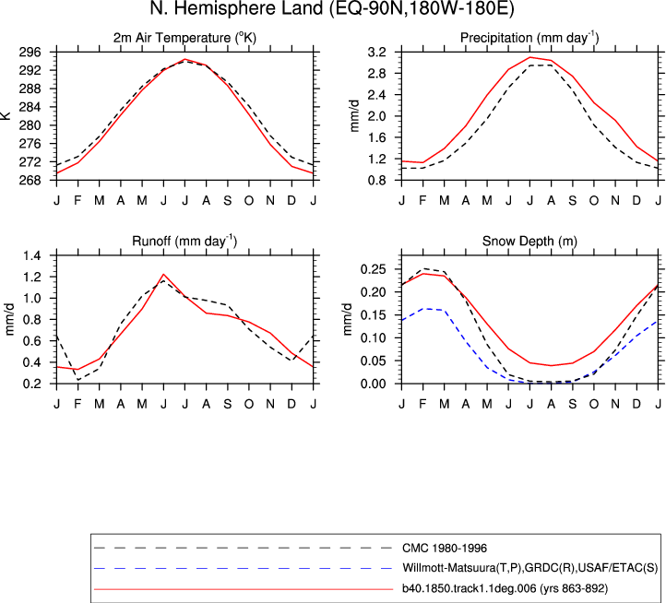
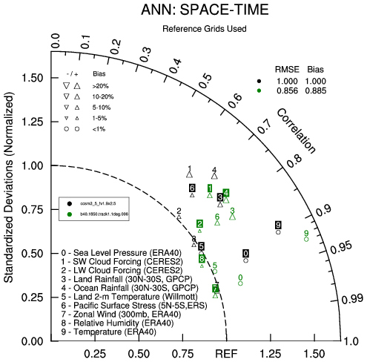
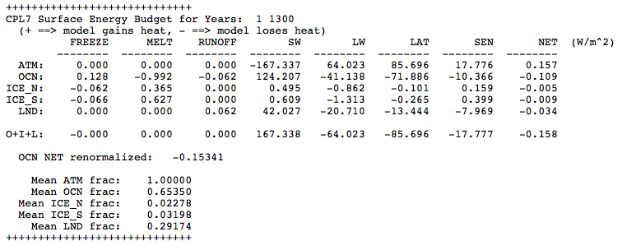
Diagnostics Packages
What are they?
A set of NCL/python scripts that automatically generate a variety of different plots from model output files that are used to evaluate a simulation.
How many packages are there?
4 Comp: Atmosphere, Ice, Land, Ocean
1 Next Generation Comp: ADF
2 Climate: CVDP, CVDP-LE
Why are they used?
The diagnostics are the easiest and fastest way to get a picture of the mean climate of your simulation. They can also show if something is wrong.
Note: The component diagnostics packages can be used as the first step in the research process, but the general nature of the calculations does not lend itself to in-depth investigation.
http://www.cesm.ucar.edu/models/cesm2.0/model_diagnostics/
VI. Practical Lab #3: Diagnostics Packages

Slide 35
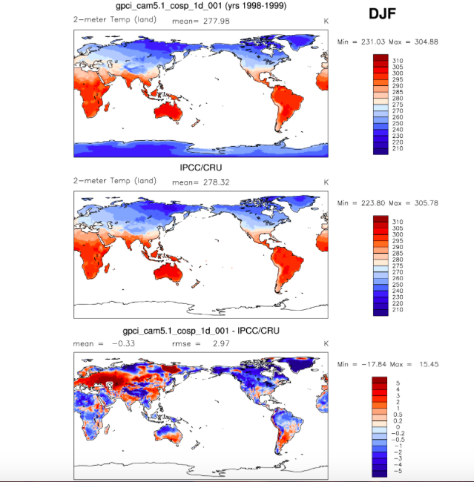
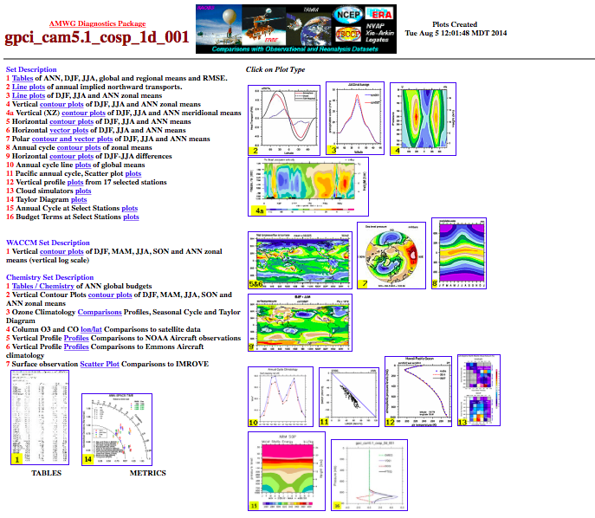
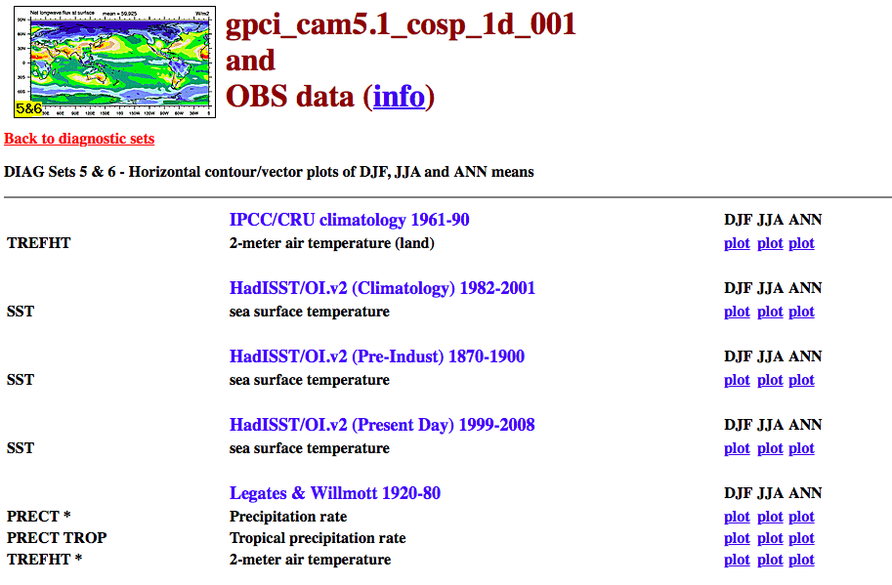
Diagnostics Packages
AMWG Diagnostics
Package Output
VI. Practical Lab #3: Diagnostics Packages

Slide 36
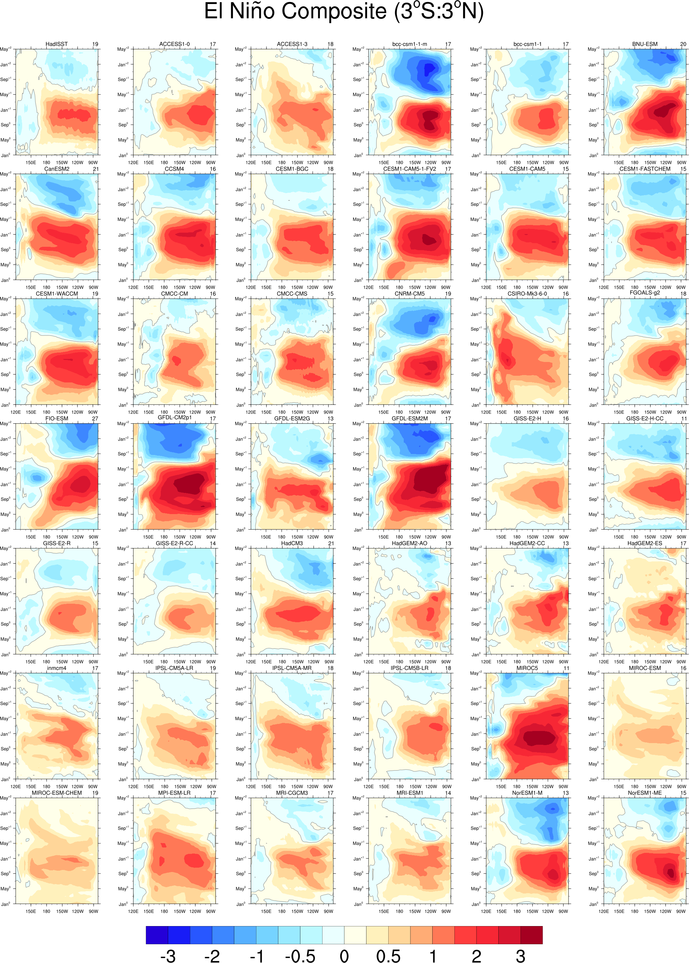
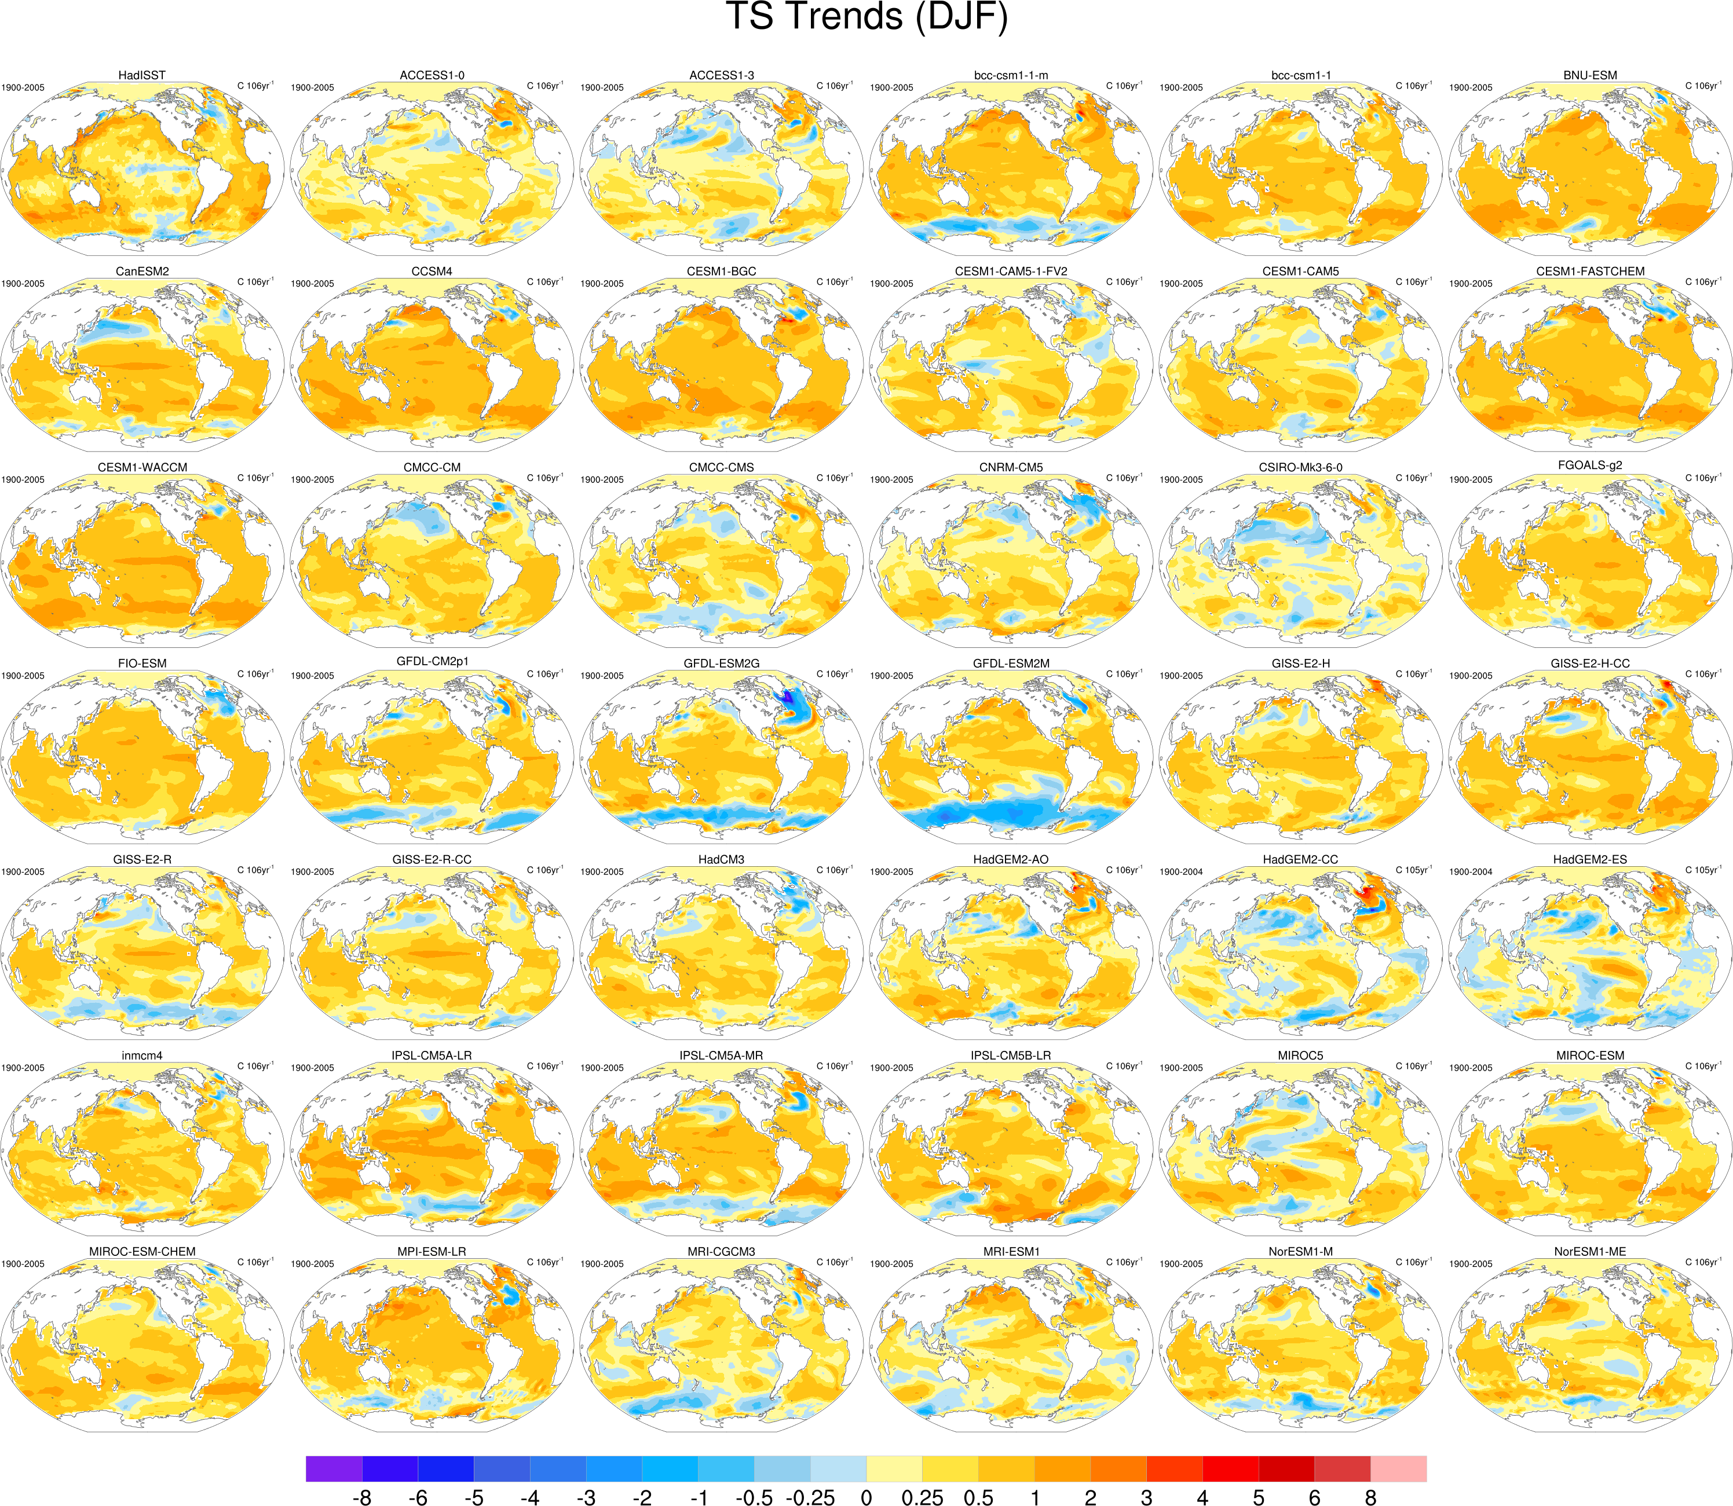
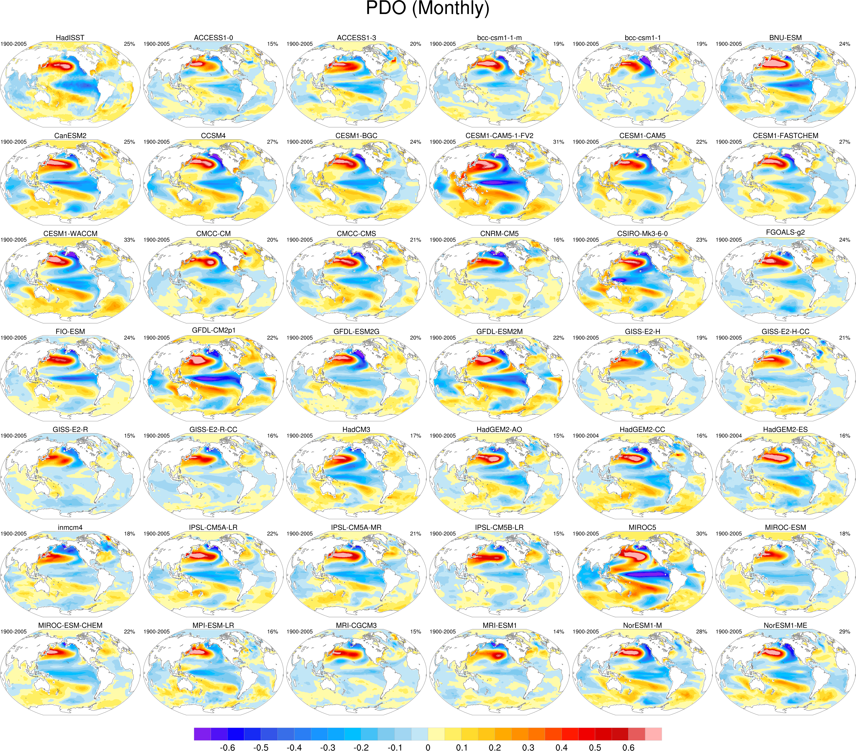
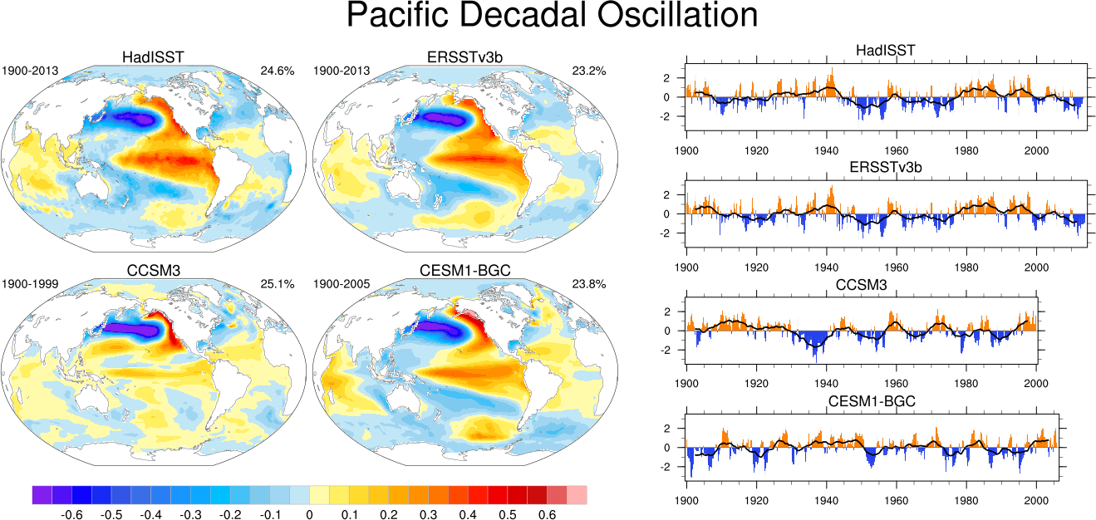
Climate Variability Diagnostic Package
The Climate Variability Diagnostics Package (CVDP) is the newest of the diagnostics packages. The CVDP calculates the major modes of
variability (AMO, PDO, NAM, etc.), AMOC metrics, and trends amongst other calculations.
Unlike the other diagnostics packages, this package is run over decades/centuries and allows multiple simulations to be input at once. Data from the CMIP3/5/6 archives are also allowed, allowing intercomparisons between CESM and other models. Calculations can be output to netCDF files for future use.
The CVDP is a component of the Earth System Model Validation Tool (ESMValTool).
VI. Practical Lab #3: Diagnostics Packages

Slide 37
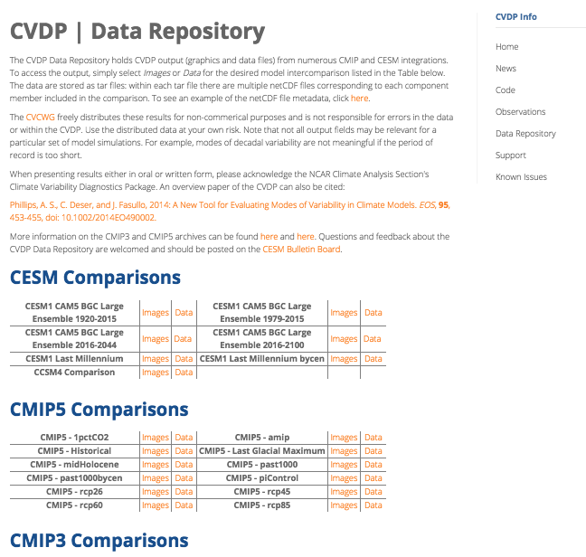
Climate Variability Diagnostic Package
The CVDP website also contains a Data Repository where we provide CVDP output for many of the CMIP3, CMIP5 and CMIP6 simulations, as well as for general CESM simulations.
http://www.cesm.ucar.edu/working_groups/CVC/cvdp/
VI. Practical Lab #3: Diagnostics Packages

Slide 38
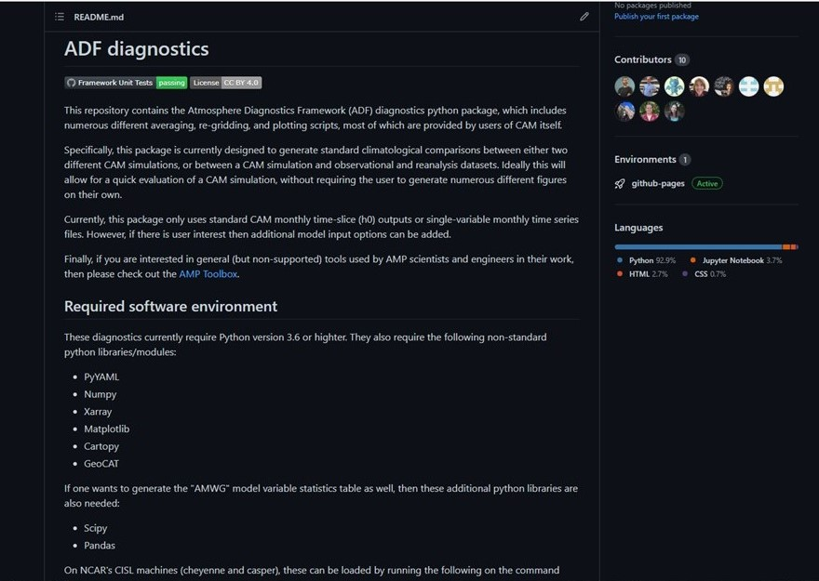
AMWG Diagnostics Framework (ADF)
The ADF is the start of a new crop of diagnostics packages which are almost
entirely python-based, and designed to be easily portable to other institutions, as well as take advantage of new development work at UCAR and elsewhere.
The ADF will currently only work for CAM data, although it can also automatically run the CVDP as well.
https://github.com/NCAR/ADF
VI. Practical Lab #3: Diagnostics Packages

Slide 39
Diagnostics Packages
Many different types of comparisons are possible using the options provided. Here, we have you set a few options to compare observations to your model run. You can also use the diagnostics to compare model runs to one another, regardless of model version.
Typically, 10-25 year time slices of data are analyzed using the component diagnostics. (Exception: The ocean timeseries diagnostics are usually run on the entire simulation.) Here, you only have ~3 years of data, so that’s what we will use.
The diagnostics packages are all available off of github. If you wish to take these diagnostics packages back with you to your home institution, you will need to have the netCDF operators and NCL installed, as well as Image Magick.
After running a diagnostics package, it is suggested you open up Firefox on cheyenne/casper as the created images are linked using a webpage. If Firefox gives you any trouble, you can always tar up the diagnostic results and scp them to a machine of your choosing.
VI. Practical Lab #3: Diagnostics Packages

Slide 40
Diagnostics Packages
Each component diagnostics package has different requirements in terms of the minimum amount of data required for them to run. (Ocean: 12 months, Atmosphere, Land: 14 months, Ice: 24 months)
If you do not have the amount of data needed to run a specific diagnostics package, there is a directory set up with 3 years of a Day 2 case here: /glade/scratch/asphilli/archive/b.day2.1
(Path also given in test_data_location.txt file found in scripts/ directory.)
Only complete years can be analyzed by the packages, and there has to be an additional December before the 1st analyzed year or an additional January and February the year after the last analyzed year. If you have 14 complete years of data you cannot set the first analyzed year to 1 and the last analyzed year to 14. Either set the first analyzed year to 2 or the last analyzed year to 13.
Do not enter leading 0’s. example: “12” not “0012”
You can usually ignore the various NCL/convert warning messages within the log files, as frequently there are model variables missing that the packages expect. You will know when it is an error message you should address.
VI. Practical Lab #3: Diagnostics Packages

Slide 41
Practical Lab #3
Within the lab, you will have the opportunity to play with the CESM history files that you created. There are 6 sets of diagnostics scripts, 4 NCL post-processing scripts, and 7 NCL graphics creating scripts. You will also be able to try out the various software packages discussed earlier (ncview, NCO, etc.).
The following slides contain information about how to run the various scripts on cheyenne, along with exercises that you can try. It is suggested that you first focus on running those scripts written for the model component that you’re most interested in. For instance, if you’re an oceanographer, try running the ocean diagnostics script, along with the ocean post-processing script and ocean graphics NCL scripts.
Once you’ve completed running one of the diagnostics packages, take a run at one of the other packages, or try the exercises/challenges on the last two slides.
You are not expected to run every diagnostics package and exercise.
VI. Practical Lab #3: Diagnostics Packages

Slide 42
Diagnostics reference slide
For the 4 component packages, review slides 39-43, run through slides 43-48 for a general setup, then if you are running…
The Atmospheric Model WG diagnostics: Run through slides 49-50 to submit, run and view the diagnostics.
The Land Model WG diagnostics: Run through slides 51-52 to submit, run and view the diagnostics.
The Ocean Model WG diagnostics: Run through slides 53-55 to submit, run and view the diagnostics.
The Ice Model WG diagnostics: Run through slides 56-58 to submit, run and view the diagnostics.
For the stand alone Climate Variability Diagnostics Package (CVDP): Review slides 39-43, then run through slides 59-62.
For the ADF: Review slides 39-43, then run through slides 65-66.
VI. Practical Lab #3: Diagnostics Packages

Slide 43
Getting Started
Reminder: Do not copy and paste, as hidden characters
can mistakenly get copied.
To set up your environment for today’s lab:
Login to cheyenne by issuing this command:
ssh –Y cheyenne.ucar.edu
alternatively one can use
ssh –Y <username>@cheyenne.ucar.edu
2) If you want to try the ADF or the CVDP via the ADF, then skip
directly to slide 65. Otherwise just continue to the next slide.
VI. Practical Lab #3: Diagnostics Packages

Slide 44
Getting Started
For tcsh users: You should have a .tcshrc file already present in your home directory. If you do not, please copy over the following file:
cp /glade/p/cesm/tutorial/tcshrc ~/.tcshrc
Then, change to your home directory and source the file:
cd; source .tcshrc
If you have an existing .tcshrc file and do not wish to overwrite it please copy the contents of the /glade/p/cesm/tutorial/tcshrc file to your .tcshrc file.
For bash users: You may have a .profile file already present in your home directory. If you do not, please copy over the following file:
cp /glade/p/cesm/tutorial/profile ~/.profile
Then, change to your home directory and source the file:
cd; source .profile
If you have an existing .profile file and do not wish to overwrite it please copy the contents of the /glade/p/cesm/tutorial/profile file to your .profile file.
VI. Practical Lab #3: Diagnostics Packages

Slide 45
Getting Started
3) cd to your home directory, then create a new directory named scripts, and cd into it:
cd
mkdir scripts
cd scripts
Copy all files from my CESM_tutorial directory over to your scripts directory, and rename hluresfile (sets NCL defaults) to .hluresfile:
cp –R /glade/u/home/asphilli/CESM_tutorial/* .
mv hluresfile ../.hluresfile
VI. Practical Lab #3: Diagnostics Packages

Slide 46
Running the Component Diagnostics
The following pages contain instructions on how to run each of the four component diagnostics packages. Each qsub submission you make should take on the order of ~5 minutes.
Note that the general CESM (component) diagnostics instructions are located here:
https://github.com/NCAR/CESM_postprocessing/wiki/cheyenne-and-DAV-quick-start-guide
Customized instructions for the tutorial are given over the next few slides. You will need to change all settings that are encased in < >.
1) Set up your python environment:
cesm_pp_activate
2) Create a directory to house the CESM postprocessing code:
mkdir /glade/scratch/<username>/cesm-postprocess
VI. Practical Lab #3: Diagnostics Packages

Slide 47
Running the Component Diagnostics
Decide which simulation you will run the diagnostics on, either your run or the test case specified in ~/scripts/test_data_location.txt. Then run create_postprocess to set up your post-processing directory, and cd to that directory as follows:
create_postprocess --caseroot /glade/scratch/<username>/cesm-postprocess/<model-run>
cd /glade/scratch/<username>/cesm-postprocess /<model-run>
For instance, if you are running on your b.day2.1 simulation:
create_postprocess --caseroot /glade/scratch/<username>/cesm-postprocess/b.day2.1
cd /glade/scratch/<username>/cesm-postprocess /b.day2.1
Reminder: Your model data location:
/glade/scratch/<username>/archive/<model-run>
Note the - - syntax (not separated by a space)
VI. Practical Lab #3: Diagnostics Packages

Slide 48
Running the Component Diagnostics
You will now set options in various .xml files in preparation for running. You can do the modifications by hand, or you can do them by using the pp_config command. It is highly recommended that you use the pp_config command as that will check that your changed settings are valid.
The first file that needs modification is env_postprocess.xml. (Note that if you alternatively set up your cesm-processing directory (step 3) within the archive directory of your model run, you can skip this step as everything should be set automatically.)
Set the location of the model data:
./pp_config --set DOUT_S_ROOT=<full path of model run archive path to be analyzed> (Example: ./pp_config --set DOUT_S_ROOT=/glade/scratch/<username>/archive/b.day2.1)
Tell the diagnostics what kind of grids to expect. Our tutorial simulations use 1.9x2.5_gx1v7:
./pp_config --set ATM_GRID=1.9x2.5
./pp_config --set LND_GRID=1.9x2.5
./pp_config --set ICE_GRID=gx1v7
./pp_config --set OCN_GRID=gx1v7
./pp_config --set ICE_NX=320
./pp_config --set ICE_NY=384
VI. Practical Lab #3: Diagnostics Packages

Slide 49
Running the Atmospheric Diagnostics Package
Remember that the atmospheric diagnostics need at least 14 months to run, and that you can only specify complete years. The steps to run the atmospheric diagnostics are as follows:
1) The following commands edit settings in env_diags_atm.xml.
./pp_config --set
ATMDIAG_OUTPUT_ROOT_PATH=/glade/scratch/<username>/diagnostics-output/atm
./pp_config --set ATMDIAG_test_first_yr=<set to first year to be analyzed>
./pp_config --set ATMDIAG_test_nyrs=<set to # of years to be analyzed>
Before the atmospheric diagnostics can be run, monthly climatologies must be calculated and written to netCDF files.
To run the atmospheric averages script: qsub atm_averages
To monitor your job(s) status: qstat –u <username>
To stop your job: qdel <Job ID retrieved from qstat>
You can check progress by checking the newest log file in logs/. If in a log file you notice that things have gone wrong, you can stop your job.
VI. Practical Lab #3: Diagnostics Packages

Slide 50
Running the Atmospheric Diagnostics Package
3) Once the averages have successfully completed (check the end of the newest log file), you can submit the diagnostics script:
qsub atm_diagnostics
4) Again monitor the status of your submission by checking the newest log file in the logs/ directory. Do not be concerned by various error messages (like convert error messages) from individual scripts in the log files. If the submission completed successfully the log file will end with “Successfully completed generating atmosphere diagnostics”.
Once the diagnostics are complete, cd to the location of the diagnostics:
cd /glade/scratch/<username>/diagnostics-output/atm/diag/<model-run>-obs.<y0>-<y1>
y0 = first year of analysis, y1 = last year of analysis
and open the index.html in firefox to examine the output:
firefox index.html &
For more information about the AMWG Diagnostics Package:
http://www.cesm.ucar.edu/working_groups/Atmosphere/amwg-diagnostics-package/
VI. Practical Lab #3: Diagnostics Packages
VI. Practical Lab #3

Slide 51
Running the Land Diagnostics Package
Remember that the land diagnostics need at least 14 months to run, and that you can only specify complete years. The steps to run the land diagnostics are as follows:
1) The following commands edit settings in env_diags_lnd.xml.
./pp_config --set
LNDDIAG_OUTPUT_ROOT_PATH=/glade/scratch/<username>/diagnostics-output/lnd
./pp_config --set LNDDIAG_clim_first_yr_1=<set to first year to be analyzed>
./pp_config --set LNDDIAG_clim_num_yrs_1=<set to # of years to be analyzed>
./pp_config --set LNDDIAG_trends_first_yr_1=<set to first year to be analyzed>
./pp_config --set LNDDIAG_trends_num_yrs_1=<set to # of years to be analyzed>
2) Before the land diagnostics can be run, monthly climatologies must be calculated and written to netCDF files.
To run the land averages script: qsub lnd_averages
To monitor your job(s) status: qstat –u <username>
To stop your job: qdel <Job ID retrieved from qstat>
You can check progress by checking the newest log file in logs/. If in a log file you notice that things have gone wrong, you can stop your job.
VI. Practical Lab #3: Diagnostics Packages

Slide 52
Running the Land Diagnostics Package
3) Once the averages have successfully completed (check the end of the newest log file), you can submit the diagnostics script:
qsub lnd_diagnostics
4) Again monitor the status of your submission by checking the newest log file in the logs/ directory. Do not be concerned by various error messages (like convert error messages) from individual scripts in the log files. If the submission completed successfully the log file will end with “Successfully completed generating land diagnostics”.
Once the diagnostics are complete, cd to the land diagnostics directory:
cd /glade/scratch/<username>/diagnostics-output/lnd/diag/<model-run>-obs.<yr1>_<yr2>
and open the setsIndex.html in firefox to examine the output:
firefox setsIndex.html &
For more information about the LMWG Diagnostics Package:
http://www.cesm.ucar.edu/models/cesm1.2/clm/clm_diagpackage.html
VI. Practical Lab #3: Diagnostics Packages

Slide 53
Running the Ocean Diagnostics Package
Historically the ocean diagnostics package consisted of three separate sets of scripts, one that compared a model run to observations, one that compared a model run to another model run, and one that calculated timeseries. Here, you will compare your simulation to observations and calculate ocean timeseries. Remember that the ocean diagnostics need at least 12 months to run, and that you can only specify complete years. The steps to run the ocean diagnostics are as follows:
1) The following commands edit settings in env_diags_ocn.xml.
./pp_config --set OCNDIAG_YEAR0=<set to first year to be analyzed>
./pp_config --set OCNDIAG_YEAR1=<set to last year to be analyzed>
./pp_config --set OCNDIAG_TSERIES_YEAR0=<set to first year to be analyzed>
./pp_config --set OCNDIAG_TSERIES_YEAR1=<set to last year to be analyzed>
./pp_config --set OCNDIAG_TAVGDIR=/glade/scratch/<username>/
diagnostics-output/ocn/climo/tavg.$OCNDIAG_YEAR0.$OCNDIAG_YEAR1
./pp_config –set OCNDIAG_WORKDIR=/glade/scratch/<username>/
diagnostics-output/ocn/diag/<model-run>.$OCNDIAG_YEAR0.$OCNDIAG_YEAR1
If the latter two commands result in an error message, instead of using “.$OCNDIAG” syntax use “.\$OCNDIAG”. Alternatively, edit the env_diags_ocn.xml file manually to set those two directory paths.
VI. Practical Lab #3: Diagnostics Packages

Slide 54
Running the Ocean Diagnostics Package
2) Before the ocean diagnostics can be run, monthly climatologies must be calculated and written to netCDF files.
To run the ocean averages script: qsub ocn_averages
To monitor your job(s) status: qstat –u <username>
To stop your job: qdel <Job ID retrieved from qstat>
You can check progress by checking the newest log file in logs/. If in a log file you notice that things have gone wrong, you can stop your job.
3) Once the averages have successfully completed (check the end of the newest log file), you can submit the diagnostics script:
qsub ocn_diagnostics
4) Again monitor the status of your submission by checking the newest log file in the logs/ directory. Do not be concerned by various error messages (like convert error messages) from individual scripts in the log files. If the submission completed successfully the log file will end with “Successfully completed generating ocean diagnostics …..”.
VI. Practical Lab #3: Diagnostics Packages

Slide 55
Running the Ocean Diagnostics Package
Once the diagnostics are complete, cd to the location
of the diagnostics:
cd /glade/scratch/<username>/diagnostics-output/ocn/diag/<model-run>.<yr1>-<yr2>
and open the index.html in firefox to examine the output:
firefox index.html &
VI. Practical Lab #3: Diagnostics Packages

Slide 56
Running the Ice Diagnostics Package
Remember that the ice diagnostics need at least 24 months to run , and that you can only specify complete years. The steps to run the ice diagnostics are as follows:
1) The following commands edit settings in env_diags_ice.xml.
./pp_config --set ICEDIAG_BEGYR_CONT=<set to first year to be analyzed>
./pp_config --set ICEDIAG_ENDYR_CONT=<set to last year to be analyzed>
./pp_config --set ICEDIAG_YRS_TO_AVG = <set to # of years to average over>
./pp_config --set ICEDIAG_PATH_CLIMO_CONT=/glade/scratch/<username>/diagnostics-output/ice/climo/$ICEDIAG_CASE_TO_CONT/
./pp_config --set ICEDIAG_DIAG_ROOT=/glade/scratch/<username>/diagnostics-output/ice/diag/$ICEDIAG_CASE_TO_CONT/
If the latter two commands result in an error message, instead of using “/$ICEDIAG” syntax use “/\$ICEDIAG”. Alternatively, edit the env_diags_ice.xml file manually to set those two directory paths.
VI. Practical Lab #3: Diagnostics Packages

Slide 57
Running the Ice Diagnostics Package
2) Before the ice diagnostics can be run, monthly climatologies must be calculated and written to netCDF files.
To run the ice averages script: qsub ice_averages
To monitor your job(s) status: qstat –u <username>
To stop your job: qdel <Job ID retrieved from qstat>
You can check progress by checking the newest log file in logs/. If in a log file you notice that things have gone wrong, you can stop your job.
3) Once the averages have successfully completed (check the end of the newest log file), you can submit the diagnostics script:
qsub ice_diagnostics
VI. Practical Lab #3: Diagnostics Packages

Slide 58
Running the Ice Diagnostics Package
4) Again monitor the status of your submission by checking the newest log file in the logs/ directory. Do not be concerned by various error messages (like convert error messages) from individual scripts in the log files. If the submission completed successfully the log file will end with “Successfully completed generating ice diagnostics”.
Once the diagnostics are complete, cd to the location of the diagnostics:
cd /glade/scratch/<username>/diagnostics-output/ice/diag/<model-run>/
<model-run>-obs/yrs<yr1>-<yr2>
and open the index.html in firefox to examine the output:
firefox index.html &
VI. Practical Lab #3: Diagnostics Packages

Slide 59
NCL post-processing scripts
All 4 post-processing scripts are quite similar, and are located in your scripts directory. To list them, type: ls *create* . If these scripts are used for runs other than the tutorial runs, note that the created netCDF files may get quite large (especially pop files). This can be mitigated by setting concat and concat_rm = False.
To set up the post-processing scripts, alter lines 4-12 (7-16 for atm). There are comments to the right of each line explaining what each line does.
To run the atm script (for example), type the following:
ncl atm.create_timeseries.ncl
All 4 scripts will write the post-processed data to work_dir (set at top of each script)/processed/<run>. Once the post-processing is complete, we can use the new files in our NCL graphics scripts, or view them via ncview.
VI. Practical Lab #3: Post-processing scripts

Slide 60
NCL Graphics Scripts
These scripts are set up so that they can read either raw history files from your archive directory (lnd,ice,ocn history files) or the post-processed files after they’ve been created by the NCL post-processing scripts.
You will need to modify the user defined file inputs at the top to point to your data files, either your raw history files or your newly created post-processed files. Once the files are modified, to execute the scripts, simply type (for example):
ncl atm_latlon.ncl . To see the script output use gv: gv atm_latlon.ps
There are 7 NCL graphics scripts available for you to run:
atm_latlon.ncl atm_nino34_ts.ncl ice_south.ncl
ice_north.ncl lnd_latlon.ncl ocn_latlon.ncl ocn_vectors.ncl
The ocn_vectors.ncl allows you to compare one ocean history file to another, and is more complicated (you can modify the first 50 lines) than the other 6 scripts. To run them, simply set the options at the top of the script.
VI. Practical Lab #3: Graphics Scripts

Slide 61
Climate Variability Diagnostics Package
The CVDP is different from the component diagnostic packages, in that the CVDP is run on timeseries/post-processed data (only), and can be run on non-CESM data. Input models do not need to be on the same grid. The CVDP can also be run on 2+ simulations at once. Entire simulations (spanning 100’s of years) can be passed into the package, but note that your ~5yr tutorial simulations are too short to put in the CVDP.
All input file names must end with the standard CMIP5/6 file naming syntax “YYYYMM-YYYYMM.nc”. Soft links can be used to meet this requirement.
The CVDP reads in 8 variables: aice, MOC, PRECC, PRECL, PSL, SNOWDP, TREFHT, and TS. (CMIP names: sic/siconc, msftmyz/msftmz, pr, psl, snd, tas, ts)
Three scripts need to be set up to run the CVDP:
namelist (lists the location of model run data to be analyzed)
namelist_obs (specified which observational datasets to use)
driver.ncl (sets CVDP options)
For the lab session, you will have the chance to run the CVDP on three simulations from the CESM1 Large Ensemble Project.
https://www.cesm.ucar.edu/projects/community-projects/LENS
VI. Practical Lab #3: Diagnostics Packages

Slide 62
Climate Variability Diagnostics Package
Login to Cheyenne, then jump onto a processing machine:
execcasper –A UESM0011 (=log on to casper)
Note: If X11 forwarding is not working on casper, open a 2nd terminal window on cheyenne, and use this second window for editing/viewing.
2) cd to your scripts directory, then into CVDP:
cd ~/scripts/CVDP
3) Open up the namelist using your favorite text editor:
gedit namelist (or use xemacs, vi, etc.)
The format of each row in namelist is as follows:
Run Name | Path to all data for a simulation | Analysis start year | Analysis end year
Modify each of the three rows so that the analysis start and end years are specified as 1979 and 2015. (They can be different though.) Note that “ | “ serves as the delimiter.
VI. Practical Lab #3: Diagnostics Packages

Slide 63
Climate Variability Diagnostics Package
4) Open up the namelist_obs:
gedit namelist_obs (or use xemacs, vi, etc.)
The format of each row in namelist_obs is as follows:
Variable | Obs Name | Path to obs dataset | Analysis start year | Analysis end year
namelist_obs is already set appropriately, so no changes need to be made. These datasets are not distributed with the CVDP, but can be downloaded online. Note that one can specify as many datasets as needed per variable, and that MOC, SNOWDP, aice_nh and aice_sh
do not have observational datasets and are not listed.
5) Open up the driver.ncl:
gedit driver.ncl (or use xemacs, vi, etc.)
Modify:
line 7 replace “user” with your username
line 18 change “False” to “True” to output calculations to netCDF
VI. Practical Lab #3: Diagnostics Packages

Slide 64
Climate Variability Diagnostics Package
6) Run the CVDP on one of cheyenne’s compute nodes by submitting driver.ncl:
ncl driver.ncl
7) Once the CVDP is complete (~20 mins), cd to the outdir specified in driver.ncl, fire up a firefox window, and open up the index.html file:
cd /glade/scratch/<username>/CVDP
firefox index.html &
VI. Practical Lab #3: Diagnostics Packages

Slide 65
The AMWG Diagnostics Framework
Access Casper, which is the Data Analysis and Visualization machine:
execcasper –A UESM0011 -l select=1:ncpus=8
Modify environment to use the NCAR python library (NPL):
module unload python
module load git
module load conda
conda activate npl
If running the CVDP via the ADF, then you also need to load ncl:
module load ncl
3. Download the ADF from Github:
git clone https://github.com/NCAR/ADF.git
cd ADF
Copy tutorial config file to your own ADF directory:
cp ~nusbaume/ADF_tutorial.yaml ADF_tutorial.yaml
VI. Practical Lab #3: Diagnostics Packages

Slide 66
The AMWG Diagnostics Framework Cont.
5. Modify the “ADF_tutorial.yaml“ file.
gedit ADF_tutorial.yaml (can also use emacs, vi, nano, etc.)
set variable “user” to your username (e.g. nusbaume)
If also running the CVDP via the ADF, then also set the variable “cvdp_run” to true
Finally, the ADF defaults to model vs baseline model. If you prefer to compare against obs, also set “compare_obs” to true.
Run the ADF
./run_adf_diag ADF_tutorial.yaml
Examine the output
cd /glade/scratch/<username>/ADF/plots/b.day2.1_1_3_vs_b.e20.BHIST.f09_g16.20thC.125.02/
firefox index.html
If also running the CVDP via the ADF, then you can also access the CVDP results here:
cd /glade/scratch/<username>/ADF/cvdp/b.day2.1/output
firefox index.html
VI. Practical Lab #3: Diagnostics Packages

Slide 67
Exercises
Use ncdump to examine one of the model history files. Find a variable you’ve never heard of, then open up the same file using ncview, and plot that variable.
Modify one of the NCL scripts to plot a different variable.
Use the netCDF operators to difference two files. Plot various fields from the difference netCDF file using ncview.
Use the netCDF operators to concatenate sea level pressure and the variable date from all the monthly atmospheric history files (.h0.) from one of your model simulations into one file.
Same as 5), but only do this for the Northern Hemisphere.
Same as 6), but don’t append the global history file attribute.
VI. Practical Lab #3: Exercises

Slide 68
Challenges
Add a variable or 3 to one of the post-processing scripts, then modify one of the NCL scripts to plot one of the new variables.
Alternatively, try adding additional variables to the ADF (look in the ADF_tutorial.yaml file for how to do that).
2) Use the atmospheric diagnostics package to compare 2 simulations to one another. (Use one or two of the model simulations provided in test_data_location.txt).
Alternatively, use the ADF to compare the model against observations (look in the ADF_tutorial.yaml file for how to do that).
3) Use the ocean diagnostics package to compare 2 simulations to one another.
VI. Practical Lab #3: Challenges

Slide 69
Supplemental Slides

Slide 70
ImageMagick
ImageMagick is a free suite of software that that can be used to display, manipulate, compare or convert images. It can also be used to create movies.
There are two ways to use ImageMagick. One way is to simply display the image and alter it using pop-up menus visible after clicking on the image:
display plot1.png
A second way is to alter an image at the command line, which is usually the faster and cleaner way to do it:
convert –density 144 –rotate 270 plot2.ps plot2.jpg
(set the resolution to 2x default, rotate the image 270 degrees,
and convert to a jpg.)
There are many options available when using convert, some of which you may need to use depending on your version of ImageMagick:
convert -trim +repage –background white –flatten plot2.ps plot2.png
(crop out all the possible white space, reset various settings, set the background to white, create a canvas based on white background while merging layers, and convert to a png.)
IV. Quick-use tools

Slide 71
ImageMagick
To compare two images (ps, pdf, png, gif, jpg, etc):
compare image1.png image2.png diff.png
diff.png will have red outlines showing what is different between
image1 and image2, while the rest of diff.png is faded out.
This works for a number of formats, including ps, pdf, png, gif and jpg.)
To create a movie from the command line:
convert –loop 0 –adjoin –delay 35 *.gif movie.mp4
(loop through the movie once, create the movie (-adjoin),
and increase the time between slides (-delay 0 is the default))
IV. Quick-use tools

Slide 72
Gv (Ghostview)
Ghostview is a simple program that allow one to view postscript files:
ghostview plot4.ps (do a which ghostview to see the path on cheyenne)
Once displayed, one can alter the orientation of the image, or change its’ size, or print specific pages amongst a group of pages. For viewing postscript (or encapsulated postscripts), ghostview should be used.
http://pages.cs.wisc.edu/~ghost/gv/index.htm
xxdiff
xxdiff allows one to
quickly compare two or
three scripts and
highlights differences:
xxdiff script1.f script2.f
http://furius.ca/xxdiff/
IV. Quick-use tools

