Slide 1
Ocean Modeling II
Parameterized Physics
Peter Gent
Oceanography Section
NCAR

Slide 2
PARAMETERIZATIONS IN CESM2 POP2
Vertical mixing (momentum and tracers)
- surface boundary layer
- interior
Lateral mixing: mesoscale eddies (tracers)
Horizontal viscosity (momentum)
Overflows
Submesoscale eddies (tracers)
Estuary box model parameterization
Solar absorption

Slide 3
VERTICAL MIXING SCHEME:
K-PROFILE PARAMETERIZATION (KPP)
1994
Unresolved turbulent vertical mixing due to small-scale overturning motions parameterized as a vertical diffusion.
Guided by study and observations of atmospheric boundary layer
where K_{x} represents an “eddy diffusivity” or “eddy viscosity”
and X = { active/passive scalars or momentum }
parameterize

Slide 4
VERTICAL MIXING SCHEME:
K-PROFILE PARAMETERIZATION (KPP)
KPP is not just a vertical diffusion scheme because the scalars (Temp and Salinity) have non-local or “countergradient” terms γ_{x}
KPP involves three high-level steps:
  1. Determination of the boundary layer (BL) depth: d
  2. Calculation of interior diffusivities: υ_{x}
  3. Evaluation of boundary layer (BL) diffusivities: K_{x}
Diffusivity throughout the boundary layer depends on the surface forcing, the boundary layer depth, and the interior diffusivity.
KPP produces quite large diffusivities below the boundary layer, which mixes temp and salinity quite deep in times of very strong surface wind stress, such as strong midlatitude atmosphere storms.
Notes:
* In KPP, ocean interior “forces” the OBL through a dependence of G(sigma) on the value of interior diffusivity

Slide 5
VERTICAL MIXING SCHEME:
K-PROFILE PARAMETERIZATION (KPP)
1. BL depth d is minimum depth where the bulk Richardson # (Ri_{b}) referenced to the surface equals a critical Richardson # (Ri_{cr}=0.3).
Stabilizing buoyancy difference
Destabilizing velocity shear
unresolved shear
B_{r} : near-surface reference buoyancy
V_{r} : near-surface reference horizontal velocity
V_{t}(d) : velocity scale of (unresolved) turbulent shear at depth d
Ri measures the stability of stratified shear flow. “Boundary layer eddies with mean velocity V_{r} and buoyancy B_{r} should be able to penetrate to the boundary layer depth, d, where they first become stable relative to the local buoyancy and velocity.”
Notes:
* In KPP, ocean interior “forces” the OBL through a dependence of G(sigma) on the value of interior diffusivity

Slide 6
VERTICAL MIXING SCHEME:
K-PROFILE PARAMETERIZATION (KPP)
2. Calculation of interior diffusivities
υ_{x} : interior diffusivity at depth d (below the boundary layer)
υ_{x}^{s} : (unresolved) shear instability
υ_{x}^{w} : internal wave breaking
υ_{x}^{d} : double diffusion
υ_{x}^{c} : local static instability (convection)
υ_{x}^{t} : tidal mixing
Superposition of processes sets interior vertical diffusivity, υ_{x}, below the surface boundary layer.
Notes:
* In KPP, ocean interior “forces” the OBL through a dependence of G(sigma) on the value of interior diffusivity

Slide 7
VERTICAL MIXING SCHEME:
K-PROFILE PARAMETERIZATION (KPP)
Verification example at Ocean Weather Station Papa (50ºN, 145ºW):
Large et al (1994)
Notes:
* For unstable forcing, w_x is capped at sigma=epsilon value.

Slide 8
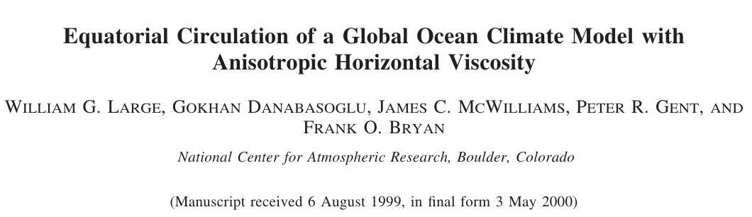
JPO
2001
LAPLACIAN HORIZONTAL VISCOSITY
Isotropic, spatially varying coefficient in Cartesian coordinates
D(U) = (A U_{x} )_{x} + (A U_{Y} )_{y}
D(V) = (A V_{x} )_{x} + (A V_{Y} )_{y}

Slide 9
ANISOTROPIC HORIZONTAL VISCOSITY
Need the viscosity matrix to be symmetric in order to satisfy a number of constraints on the viscosity.
Small B in u equation does not diffuse strong, but thin, equatorial currents, such as the equatorial undercurrent.
Small B in v equation does not diffuse strong, but thin, western boundary currents, such as the Gulf Stream.

Slide 10
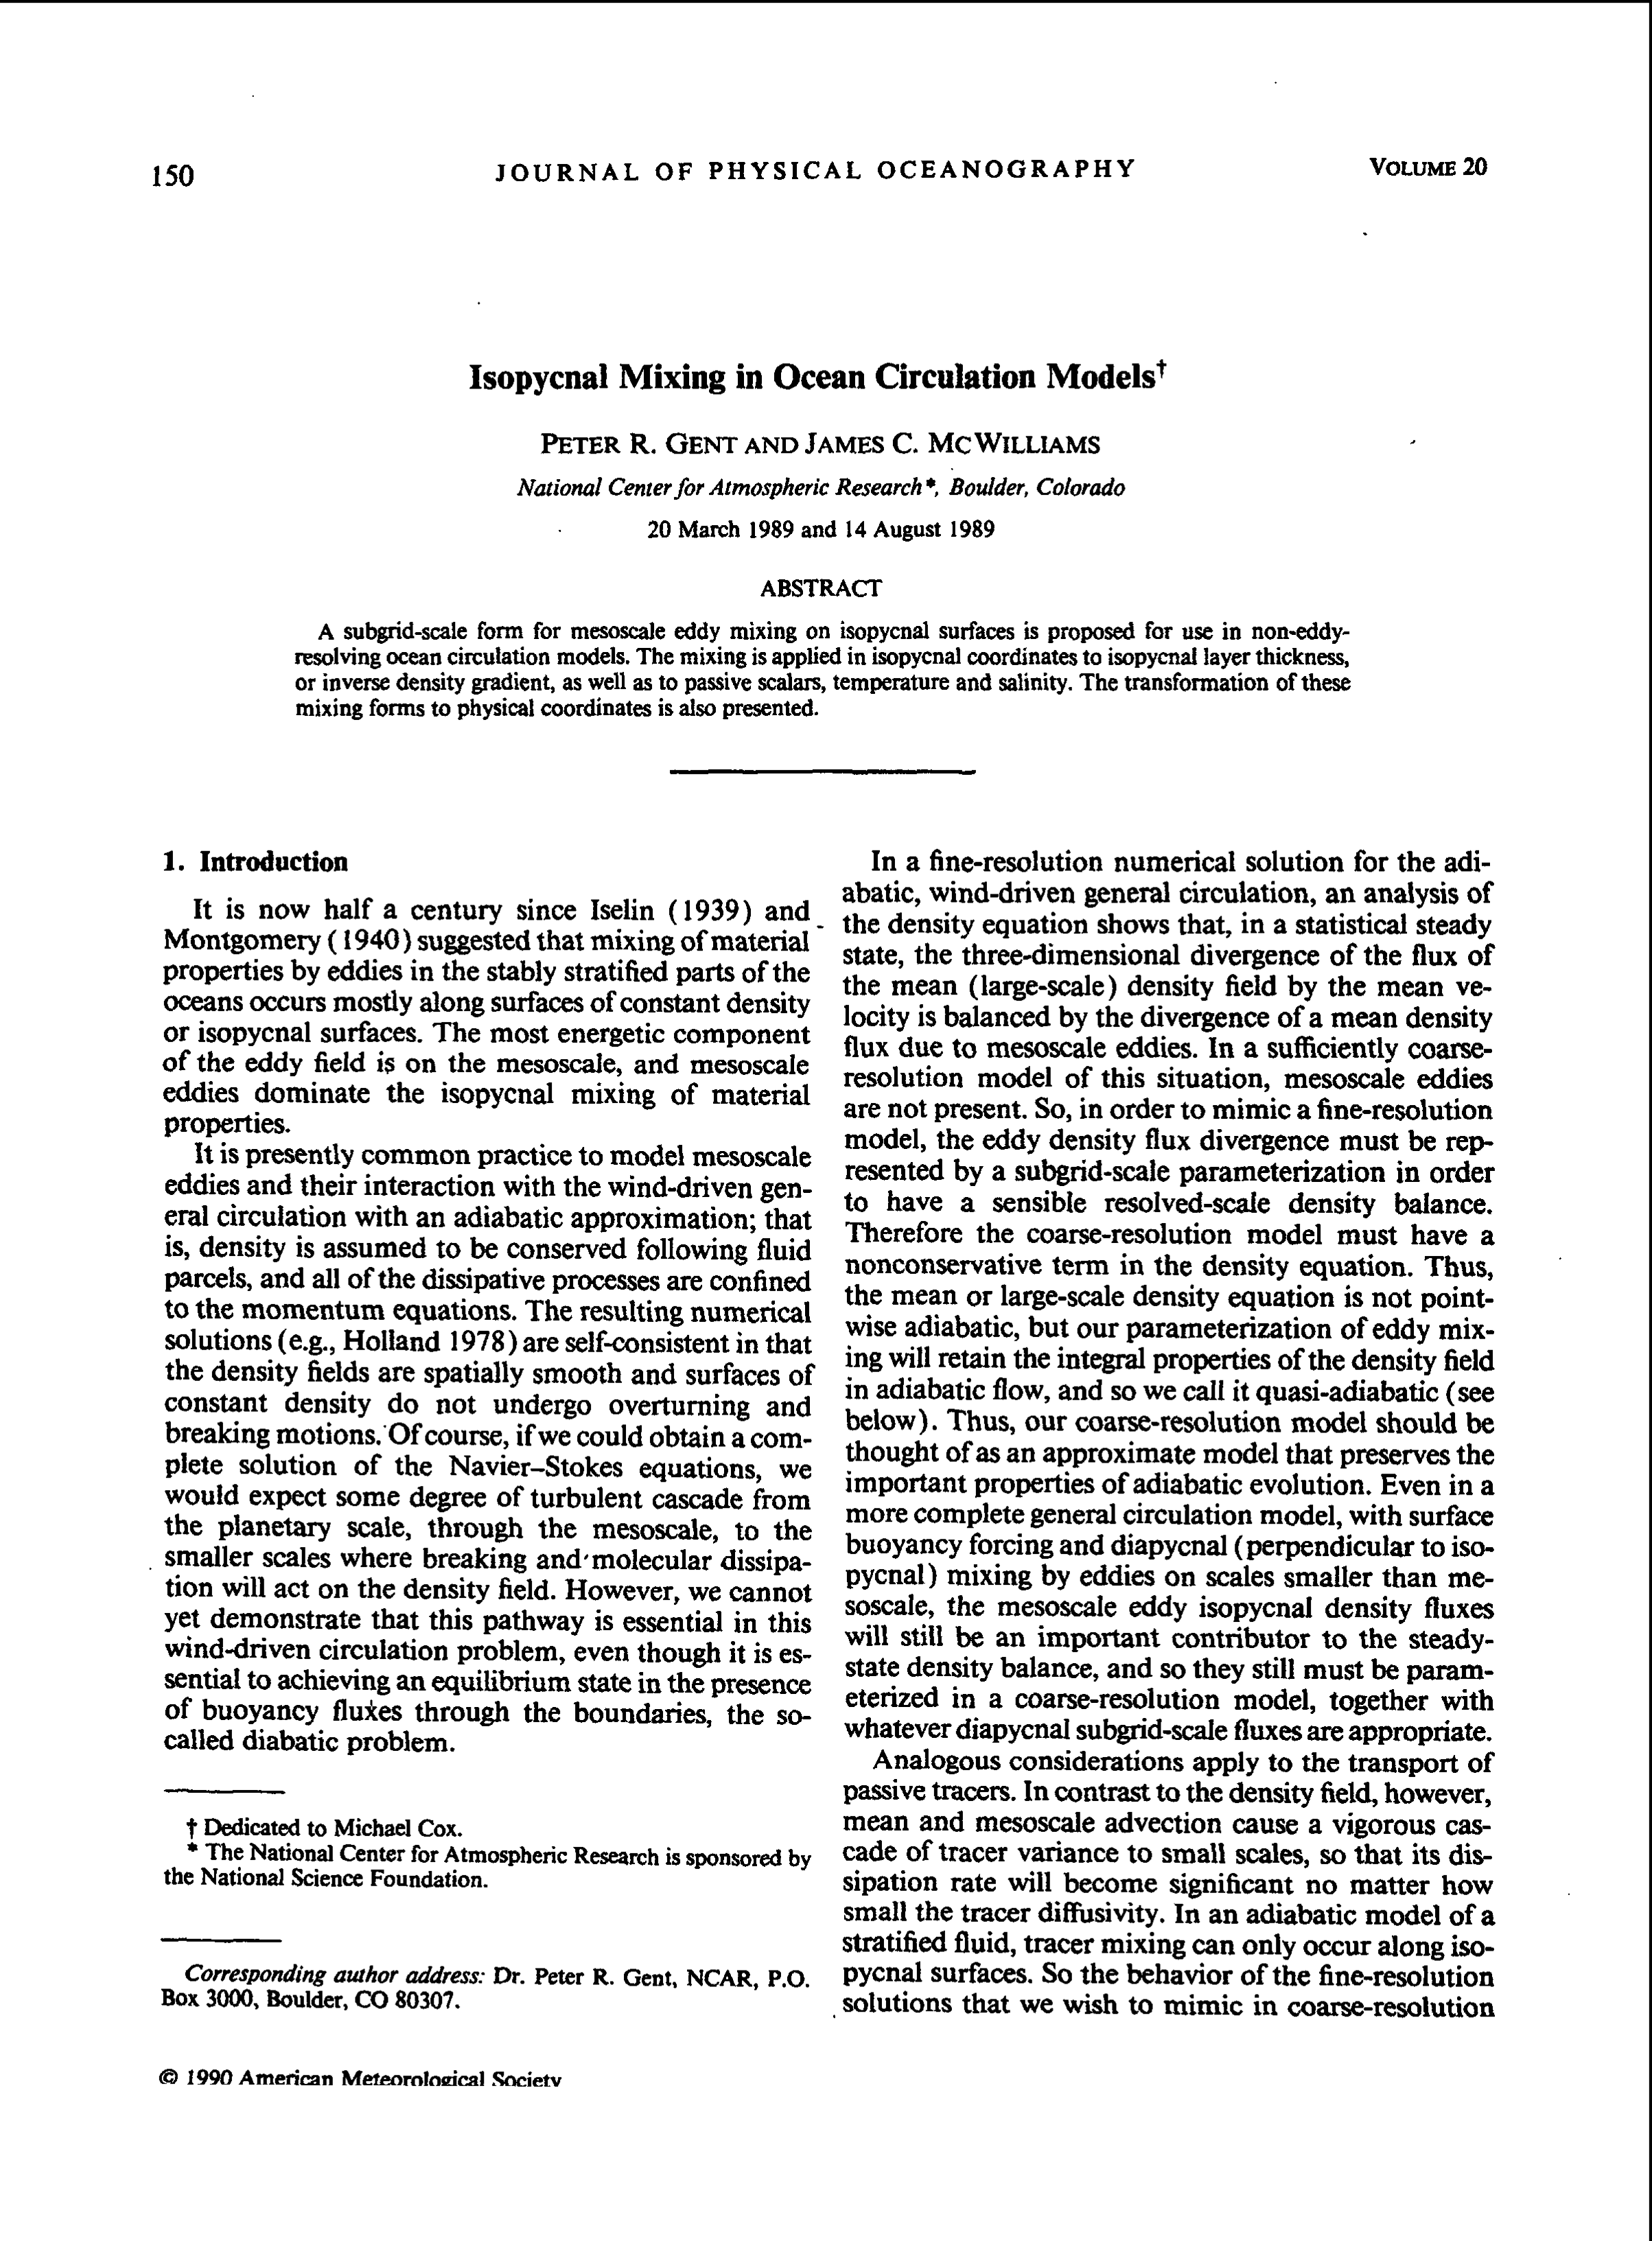
Mesoscale eddy mixing of tracers:
Gent-McWilliams (GM) parameterization
Lateral Mixing (Interior, Tracer Diffusion)
1990
2011
Notes:
In the last sentence, is this mixing along depth surfaces causes spurious diapycnal mixing??

Slide 11
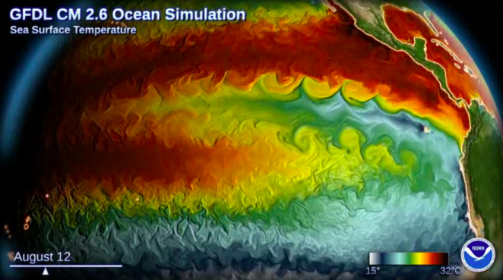
GFDL climate model with ocean resolution of 0.1º

Slide 12
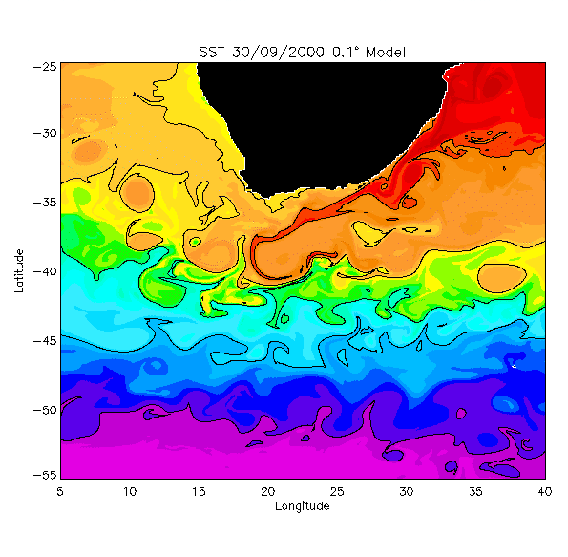
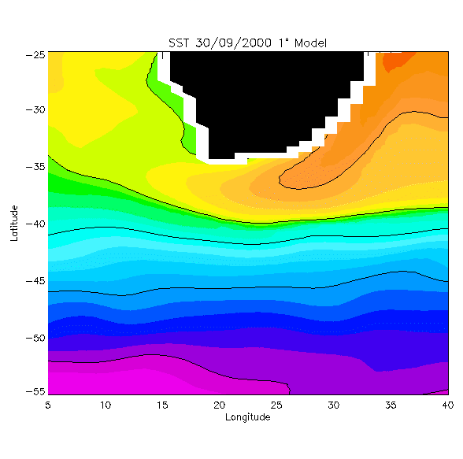
Why is GM needed?
Lateral Mixing (Interior, Tracer Diffusion)
Agulhas Retroflection
O(1º) models do not resolve the 1st baroclinic deformation radius away from the equatorial regions, and hence lack the mesoscale turbulence which mixes temperature, salinity and passive tracers in the real ocean.
Notes:
In the last sentence, is this mixing along depth surfaces causes spurious diapycnal mixing??

Slide 13
Why is GM needed?
Isopycnal slopes are small O(10⁻³) at most
Early ocean models parameterized the stirring effects of (unresolved) mesoscale eddies by Laplacian horizontal diffusion with K_{H} = O(10³ m²/s), whereas the vertical mixing coefficient K_{v} = O(10⁻⁴ m²/s).
Horizontal mixing results in excessive diapycnal mixing, which degrades the ocean solution: e.g. Veronis (1975) showed that it produces spurious upwelling in western boundary current regions which “short circuits” the N. Atlantic MOC.
Thus, was a recognized need to orient tracer diffusion in z-coordinate models along isopycnal surfaces, to be consistent with observed ocean mixing rates.
Notes:
In the last sentence, is this mixing along depth surfaces causes spurious diapycnal mixing??

Slide 14
The GM Parameterization
GM (1990) proposed an eddy-induced velocity u* in addition to diffusion along isopycnal surfaces.

Slide 15
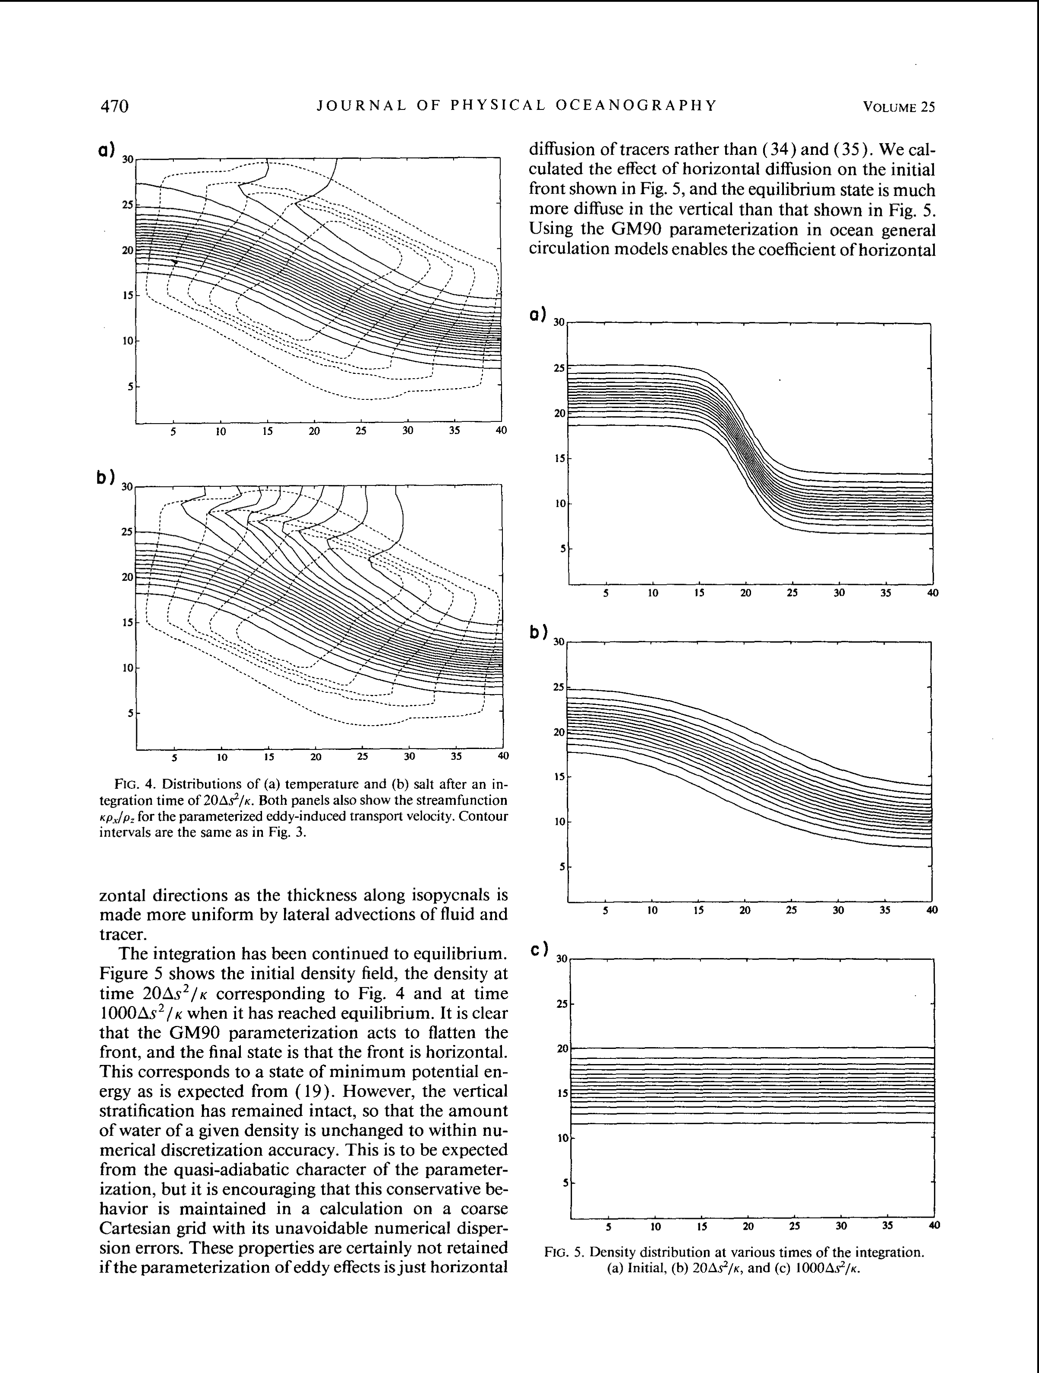
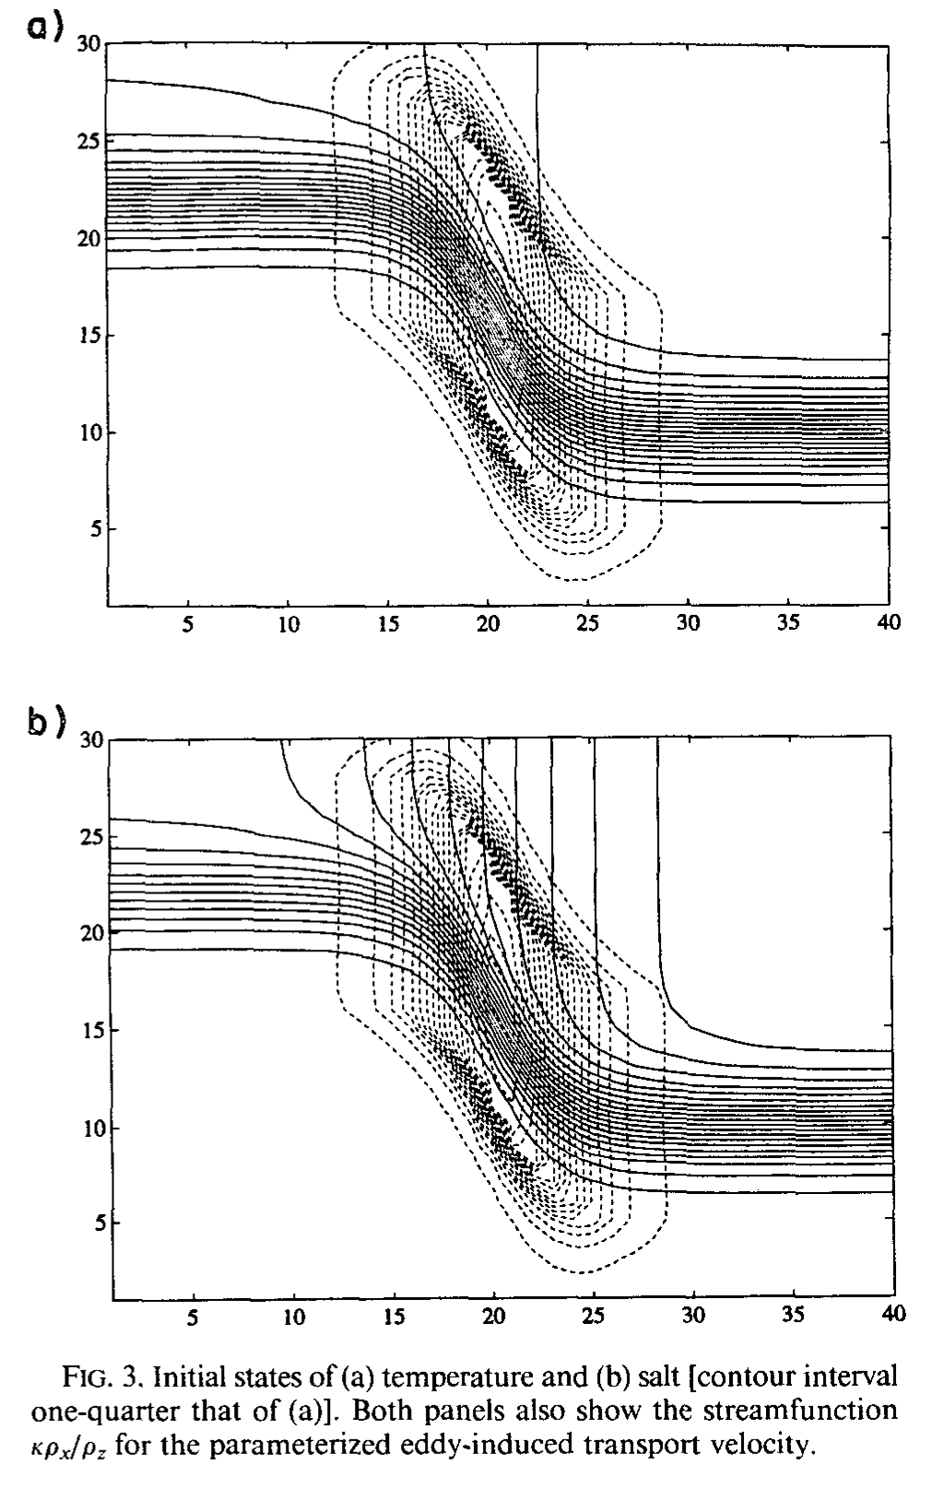
GM impacts
Gent et al. (JPO, 1995): Eddy-induced velocity (v*,w*) acts to flatten isopycnals and minimize potential energy.
Density
Temperature
light
Temperature
warm
dense
cold
time
Salinity
Salinity
salty
fresh

Slide 16
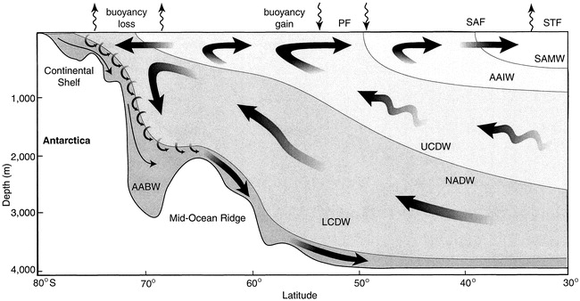
Southern Hemisphere zonal wind jet
Baroclinic instability produces ACC eddies that try to flatten the isopycnals and produce a MOC that opposes the mean flow MOC.

Slide 17
Southern Hemisphere zonal wind jet
Mean MOC
Eddy MOC
Baroclinic instability produces ACC eddies that try to flatten the isopycnals and produce a MOC that opposes the mean flow MOC.

Slide 18
Impacts of GM
Horizontal Diffusion, MOC (u)
GM, MOC (u)
(c) GM, MOC (u+u*)
4º x 3º x 20L ocean model
Danabasoglu et al. (1994, Science)
Notes:
N Atlantic cell strengthens in (b) with elimination of Veronis effect; overturning near Antarctica weakens in (b)
Total transport, including eddy velocities, results in almost total cancellation of Deacon Cell near 50S, which was associated with excessive northward transport of cold surface waters across the ACC latitudes. Unstable density profile then led to excessive convective adjustment.

Slide 19
Impacts of GM
Deep Water Formation
Horizontal Diffusion
GM
In (b), deep water is formed only in the Greenland/ Iceland/Norwegian Sea, the Labrador Sea, the Weddell Sea and the Ross Sea.
4º x 3º x 20L ocean model
Danabasoglu et al. (1994, Science)
Notes:
With GM, convective adjustment is limited to regions where deep convection is known to occur in Nature.

Slide 20
GM summary
Mimics effects of unresolved mesoscale eddies as the sum of
- diffusive mixing of tracers along isopycnals (Redi 1982),
- an additional advection of tracers by the eddy-induced velocity u*
Scheme is adiabatic and therefore valid for the ocean interior.
Acts to flatten isopycnals, thereby reducing potential energy.
Eliminates any need for horizontal diffusion in z-coordinate OGCMs
➔ eliminates Veronis effect.
Implementation of GM in ocean component was a major factor enabling stable coupled climate model simulations without “flux adjustments”.

Slide 21
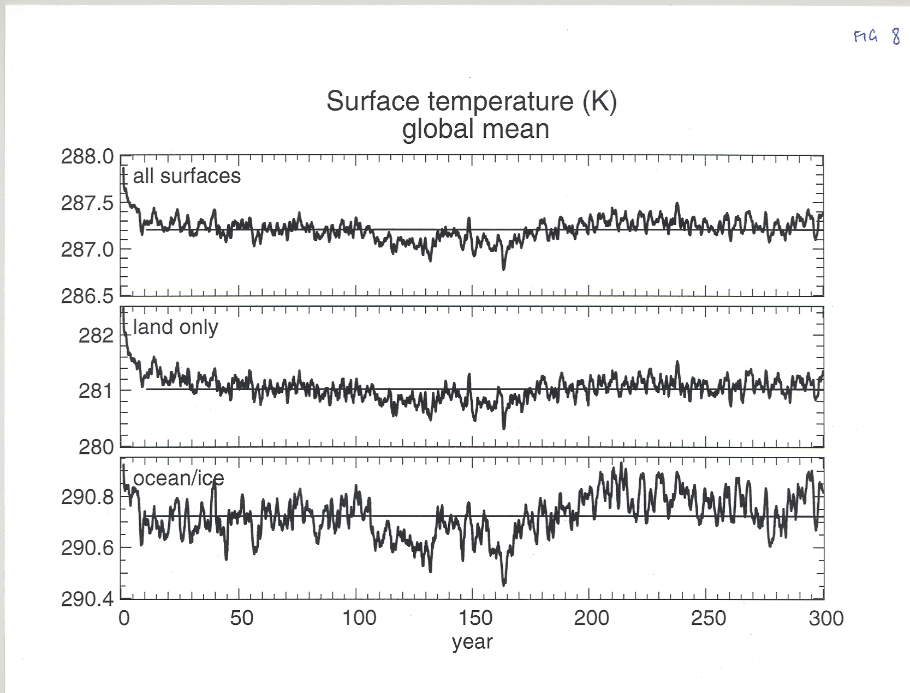
CSM1 was the first climate model to produce a non-drifting control run without flux adjustments

Slide 22


Limerick 2004
There once was an ocean model called POP,
Which occasionally used to flop,
But eddy advection, and much less convection,
Turned it into the cream of the crop.

